Slide 1
how can i live to really please god?

Slide 2
So - how can I live my life
in order to
really please God?

Slide 3
I Thessalonians 4:1-2
Finally, brothers, we instructed you how to live in order to please God, as in fact you are living. Now we ask you and urge you in the Lord Jesus to do this more and more. For you know what instructions we gave you by the authority of the Lord Jesus.

Slide 4
I Thessalonians 4:3-8
It is God’s will that you should be sanctified: that you should avoid sexual immorality; that each of you should learn to control his own body in a way that is holy and honorable, not in passionate lust like the heathen, who do not know God; and that in this matter no one should wrong his brother or take advantage of him. The Lord will punish men for all such sins, as we have already told you and warned you. For God did not call us to be impure, but to live a holy life. Therefore, he who rejects this instruction does not reject man but God, who gives you his Holy Spirit.

Slide 5
I Thessalonians 4:9-12
Now about brotherly love we do not need to write to you, for you yourselves have been taught by God to love each other. And in fact, you do love all the brothers throughout Macedonia. Yet we urge you, brothers, to do so more and more. Make it your ambition to lead a quiet life, to mind your own business and to work with your hands, just as we told you, so that your daily life may win the respect of outsiders and so that you will not be dependent on anybody.

Slide 6
I. Keep Pure Relationships with One Another - v1-8

Slide 7
I. Keep Pure Relationships with One Another.
A. What does purity mean?

Slide 8
I. Keep Pure Relationships with One Another.
A. What does purity mean?
1. That you should be sanctified.
It is God’s will that you should be sanctified: that you should avoid sexual immorality; that each of you should learn to control his own body in a way that is holy and honorable . . . - v3-4
Sanctified * = separated apart because of your spirituality.
* ἁγιασμός

Slide 9
I. Keep Pure Relationships with One Another.
A. What does purity mean?
2. That you should avoid sexual immorality.
It is God’s will that you should be sanctified: that you should avoid sexual immorality; that each of you should learn to control his own body in a way that is holy and honorable . . . - v3-4
Sexual immorality * = fornication.
* πορνεία

Slide 10
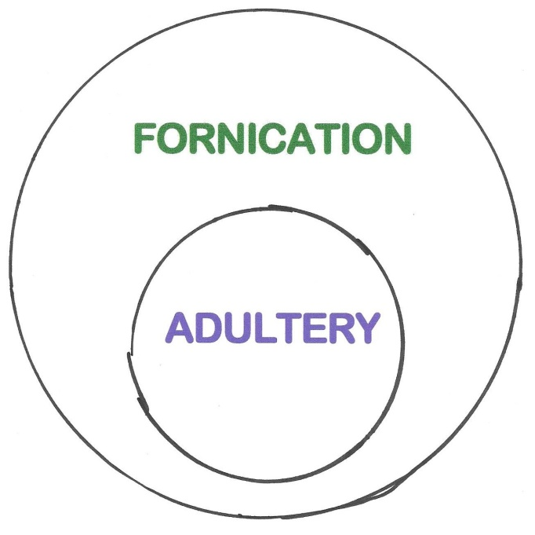
I. Keep Pure Relationships with One Another.
A. What does purity mean?
2. That you should avoid sexual immorality.

Slide 11
I. Keep Pure Relationships with One Another.
A. What does purity mean?
3. That you should learn to control your body.
It is God’s will that you should be sanctified: that you should avoid sexual immorality; that each of you should learn to control his own body in a way that is holy and honorable . . . - v3-4

Slide 12
I. Keep Pure Relationships with One Another.
B. Why is this important?

Slide 13
I. Keep Pure Relationships with One Another.
B. Why is this important?
1. It is necessary.
Finally, brothers, we instructed you how (it is necessary) to live in order to please God, as in fact you are living. Now we ask you and urge you in the Lord Jesus to do this more and more. For you know what instructions we gave you by the authority of the Lord Jesus. It is God’s will that you should be sanctified: that you should avoid sexual immorality; that each of you should learn to control his own body in a way that is holy and honorable . . . - v1-4

Slide 14
I. Keep Pure Relationships with One Another.
B. Why is this important?
2. It is a command.
Finally, brothers, we instructed you how to live in order to please God, as in fact you are living. Now we ask you and urge you in the Lord Jesus to do this more and more. For you know what instructions we gave you by the authority of the Lord Jesus. It is God’s will that you should be sanctified: that you should avoid sexual immorality; that each of you should learn to control his own body in a way that is holy and honorable . . . - v1-4

Slide 15
I. Keep Pure Relationships with One Another.
B. Why is this important?
3. It is God’s will.
Finally, brothers, we instructed you how to live in order to please God, as in fact you are living. Now we ask you and urge you in the Lord Jesus to do this more and more. For you know what instructions we gave you by the authority of the Lord Jesus. It is God’s will that you should be sanctified: that you should avoid sexual immorality; that each of you should learn to control his own body in a way that is holy and honorable . . . - v1-4

Slide 16
I. Keep Pure Relationships with One Another.
Exodus 20:14 - You shall not commit adultery.

Slide 17
I. Keep Pure Relationships with One Another.
Exodus 20:14 - You shall not commit adultery.
Job 31:1-2 - I made a covenant with my eyes not to look lustfully at a girl. For what is man’s lot from God above, his heritage from the Almighty on high?

Slide 18
I. Keep Pure Relationships with One Another.
Exodus 20:14 - You shall not commit adultery.
Job 31:1-2 - I made a covenant with my eyes not to look lustfully at a girl. For what is man’s lot from God above, his heritage from the Almighty on high?
Matthew 5:27-28 - You have heard that it was said, ‘Do not commit adultery.’ But I tell you that anyone who looks at a woman lustfully has already committed adultery with her in his heart.

Slide 19
I. Keep Pure Relationships with One Another.
B. Why is this important?
4. Your relationship with your Christian brothers will not be hampered.
. . . and that in this matter no one should wrong his brother or take advantage of him. The Lord will punish men for all such sins, as we have already told you and warned you. For God did not call us to be impure, but to live a holy life. - v6-7

Slide 20
I. Keep Pure Relationships with One Another.
B. Why is this important?
5. Your call to be a Christian was for the purpose of living a pure life.
. . . and that in this matter no one should wrong his brother or take advantage of him. The Lord will punish men for all such sins, as we have already told you and warned you. For God did not call us to be impure, but to live a holy life. - v6-7

Slide 21
I. Keep Pure Relationships with One Another - v1-8
II. Keep Love Relationships with One Another - v9-12

Slide 22
II. Keep Love Relationships with One Another.
A. What does love mean?

Slide 23
II. Keep Love Relationships with One Another.
A. What does love mean?
1. How much love is involved? More than you’re loving now.
And in fact, you do love all the brothers throughout Macedonia. Yet we urge you, brothers, to do so more and more. Make it your ambition to lead a quiet life, to mind your own business and to work with your hands, just as we told you, so that your daily life may win the respect of outsiders and so that you will not be dependent on anybody. - v10-12

Slide 24
II. Keep Love Relationships with One Another.
A. What does love mean?
2. How is it to be expressed? In practical living.
And in fact, you do love all the brothers throughout Macedonia. Yet we urge you, brothers, to do so more and more. Make it your ambition to lead a quiet life, to mind your own business and to work with your hands, just as we told you, so that your daily life may win the respect of outsiders and so that you will not be dependent on anybody. - v10-12

Slide 25
II. Keep Love Relationships with One Another.
A. What does love mean?
3. How are you to wait for the Lord’s return?
And in fact, you do love all the brothers throughout Macedonia. Yet we urge you, brothers, to do so more and more. Make it your ambition to lead a quiet life, to mind your own business and to work with your hands, just as we told you, so that your daily life may win the respect of outsiders and so that you will not be dependent on anybody. - v10-12

Slide 26
II. Keep Love Relationships with One Another.
A. What does love mean?
a. What do you do with your life? Consideration, respect, love.
And in fact, you do love all the brothers throughout Macedonia. Yet we urge you, brothers, to do so more and more. Make it your ambition to lead a quiet life, to mind your own business and to work with your hands, just as we told you, so that your daily life may win the respect of outsiders and so that you will not be dependent on anybody. - v10-12

Slide 27
II. Keep Love Relationships with One Another.
A. What does love mean?
b. What do you do with your thoughts?
And in fact, you do love all the brothers throughout Macedonia. Yet we urge you, brothers, to do so more and more. Make it your ambition to lead a quiet life, to mind your own business and to work with your hands, just as we told you, so that your daily life may win the respect of outsiders and so that you will not be dependent on anybody. - v10-12

Slide 28
II. Keep Love Relationships with One Another.
A. What does love mean?
c. What do you do with your time?
And in fact, you do love all the brothers throughout Macedonia. Yet we urge you, brothers, to do so more and more. Make it your ambition to lead a quiet life, to mind your own business and to work with your hands, just as we told you, so that your daily life may win the respect of outsiders and so that you will not be dependent on anybody. - v10-12

Slide 29
II. Keep Love Relationships with One Another.
B. Why is this important?

Slide 30
II. Keep Love Relationships with One Another.
B. Why is this important?
1. You were “taught by God”.
Now about brotherly love we do not need to write to you, for you yourselves have been taught by God to love each other. - v9

Slide 31
II. Keep Love Relationships with One Another.
B. Why is this important?
1. You were “taught by God”.
a. Through the Lord.
John 15:17 - This is my command: Love each other.

Slide 32
II. Keep Love Relationships with One Another.
B. Why is this important?
1. You were “taught by God”.
b. Through the John.
I John 4:21 - And he has given us this command: Whoever loves God must also love his brother.

Slide 33
II. Keep Love Relationships with One Another.
B. Why is this important?
1. You were “taught by God”.
c. Through the Paul.
Ephesians 5:2 - live a life of love, just as Christ loved us and gave himself up for us as a fragrant offering and sacrifice to God.

Slide 34
II. Keep Love Relationships with One Another.
B. Why is this important?
2. You were born again into a family relationship!

Slide 35
You were born again into a family relationship.
How can I live to really please God?
Keep pure and loving relationships with one another!

