Slide 1
god’s response when you are really feeling down

Slide 2
Romans 8:28
And we know that in all things God works for the good of those who love him, who have been called according to his purpose.

Slide 3
I. What is It That Works Out for Good?

Slide 4
I. What is It That Works Out for Good?
A. All things.
And we know that in all things God works for the good of those who love him, who have been called according to his purpose. - v28
All that happens to you (Living Bible)

Slide 5
I. What is It That Works Out for Good?
A. All things.
1. Examples:
Who shall separate us from the love of Christ? Shall trouble or hardship or persecution or famine or nakedness or danger or sword? - v35

Slide 6
I. What is It That Works Out for Good?
A. All things.
1. Examples:
Who shall separate us from the love of Christ? Shall trouble or hardship or persecution or famine or nakedness or danger or sword? - v35
a. Trouble * = to suffer affliction from people or circum- stances.
* θλiψις

Slide 7
I. What is It That Works Out for Good?
A. All things.
1. Examples:
Who shall separate us from the love of Christ? Shall trouble or hardship or persecution or famine or nakedness or danger or sword? - v35
b. Hardship * = “in a narrow place”, crowded, pressured.
* στενοχωρία

Slide 8
I. What is It That Works Out for Good?
A. All things.
1. Examples:
Who shall separate us from the love of Christ? Shall trouble or hardship or persecution or famine or nakedness or danger or sword? - v35
c. Persecution * = an affliction that continues to irritate.
* διωγμός

Slide 9
I. What is It That Works Out for Good?
A. All things.
1. Examples:
Who shall separate us from the love of Christ? Shall trouble or hardship or persecution or famine or nakedness or danger or sword? - v35
d. Famine * = prolonged hunger.
* λιμός

Slide 10
I. What is It That Works Out for Good?
A. All things.
1. Examples:
Who shall separate us from the love of Christ? Shall trouble or hardship or persecution or famine or nakedness or danger or sword? - v35
e. Nakedness * = body expo- sure, lack of clothes.
* γυμνότης

Slide 11
I. What is It That Works Out for Good?
A. All things.
1. Examples:
Who shall separate us from the love of Christ? Shall trouble or hardship or persecution or famine or nakedness or danger or sword? - v35
f. Danger * = the possibility of losing your life.
* κίνδυνος

Slide 12
I. What is It That Works Out for Good?
A. All things.
1. Examples:
Who shall separate us from the love of Christ? Shall trouble or hardship or persecution or famine or nakedness or danger or sword? - v35
g. Sword * = the Roman short sword, so being murdered or killed.
* μάχαιρα

Slide 13
I. What is It That Works Out for Good?
A. All things.
2. None of these things are able to separate you from the Lord’s love!

Slide 14
I. What is It That Works Out for Good?
B. What do you become when you are in Christ?

Slide 15
I. What is It That Works Out for Good?
B. What do you become when you are in Christ?
No, in all these things we are more than conquerors through him who loved us. - v37
Overwhelming victory is ours. (Living Bible)

Slide 16
I. What is It That Works Out for Good?
Why can you still have victory in spite of your trials?

Slide 17
I. What is It That Works Out for Good?
Why can you still have victory in spite of your trials?
a. Because God is still in control!

Slide 18
I. What is It That Works Out for Good?
Why can you still have victory in spite of your trials?
a. Because God is still in control!
b. Because the Lord has promised
. . . on this rock I will build my church, and the gates of Hades will not overcome it. - Matthew 16:18

Slide 19
I. What is It That Works Out for Good?
II. How Do They Work Out for Good?

Slide 20
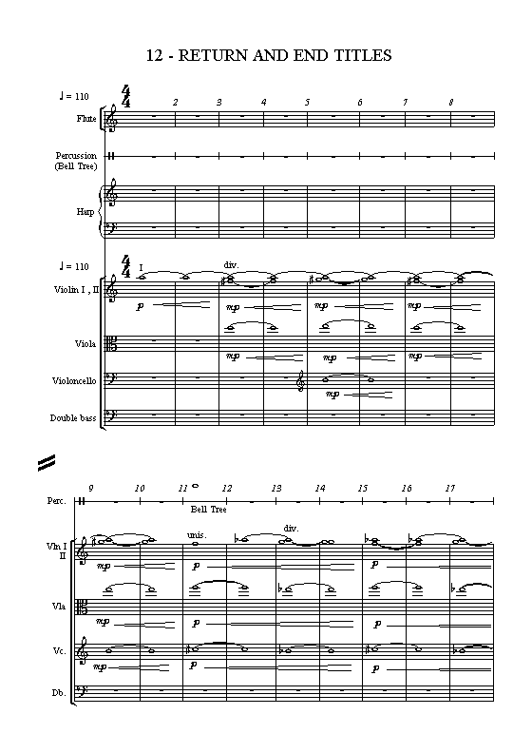
II. How Do They Work Out for Good?

Slide 21
II. How Do They Work Out for Good?
A. They work together.
And we know that in all things God works for the good of those who love him, who have been called according to his purpose. - v28
Work * = to work together.
* συνεργέω

Slide 22
II. How Do They Work Out for Good?
A. They work together.
B. They work continually.

Slide 23
II. How Do They Work Out for Good?
B. They work continually.
1. They are continually working things out for your benefit!

Slide 24
II. How Do They Work Out for Good?
B. They work continually.
2. This means God is continually making you!

Slide 25
II. How Do They Work Out for Good?
B. They work continually.
2. This means God is continually making you!
PBPGINFY Please Be Patient God Is Not Finished Yet!

Slide 26
I. What is It That Works Out for Good?
II. How Do They Work Out for Good?
III. Who Do They Work Out For?

Slide 27
III. Who Do They Work Out For?
A. Those who are loving God.
And we know that in all things God works for the good of those who love him, who have been called according to his purpose. - v28

Slide 28
III. Who Do They Work Out For?
A. Those who are loving God.
And we know that in all things God works for the good of those who love him, who have been called according to his purpose. - v28
1. Love = loving God as a way of life!

Slide 29
III. Who Do They Work Out For?
A. Those who are loving God.
And we know that in all things God works for the good of those who love him, who have been called according to his purpose. - v28
2. People who love you want . . . to be with you, to visit you.
Talk to God often!

Slide 30
III. Who Do They Work Out For?
A. Those who are loving God.
And we know that in all things God works for the good of those who love him, who have been called according to his purpose. - v28
2. People who love you want . . . to please you.
Study God’s word & obey Him!

Slide 31
III. Who Do They Work Out For?
B. Those who are called.
And we know that in all things God works for the good of those who love him, who have been called according to his purpose. - v28

Slide 32
III. Who Do They Work Out For?
B. Those who are called.
And we know that in all things God works for the good of those who love him, who have been called according to his purpose. - v28
1. Christians are people who have submitted themselves!

Slide 33
III. Who Do They Work Out For?
B. Those who are called.
And we know that in all things God works for the good of those who love him, who have been called according to his purpose. - v28
1. Christians are people who have submitted themselves!
Have you accepted Lord Jesus as Savior?

Slide 34
III. Who Do They Work Out For?
B. Those who are called.
And we know that in all things God works for the good of those who love him, who have been called according to his purpose. - v28
1. Christians are people who have submitted themselves!
Have you acknowledged Him as Lord?

Slide 35
III. Who Do They Work Out For?
B. Those who are called.
And we know that in all things God works for the good of those who love him, who have been called according to his purpose. - v28
1. Christians are people who have submitted themselves!
Have you repented of your sins?

Slide 36
III. Who Do They Work Out For?
B. Those who are called.
And we know that in all things God works for the good of those who love him, who have been called according to his purpose. - v28
1. Christians are people who have submitted themselves!
Have you confessed your loyalty to Him?

Slide 37
III. Who Do They Work Out For?
B. Those who are called.
And we know that in all things God works for the good of those who love him, who have been called according to his purpose. - v28
1. Christians are people who have submitted themselves!
Have you identified with the Lord in baptism?

Slide 38
III. Who Do They Work Out For?
B. Those who are called.
And we know that in all things God works for the good of those who love him, who have been called according to his purpose. - v28
2. Christians are people who are fulfilling God’s purposes!

Slide 39
III. Who Do They Work Out For?
B. Those who are called.
And we know that in all things God works for the good of those who love him, who have been called according to his purpose. - v28
2. Christians are people who are fulfilling God’s purposes!
Those who are fitting into His plans (Living Bible)

Slide 40
III. Who Do They Work Out For?
B. Those who are called.
And we know that in all things God works for the good of those who love him, who have been called according to his purpose. - v28
2. Christians are people who are fulfilling God’s purposes!
You were called to enjoy salvation & fellowship

Slide 41
III. Who Do They Work Out For?
B. Those who are called.
And we know that in all things God works for the good of those who love him, who have been called according to his purpose. - v28
2. Christians are people who are fulfilling God’s purposes!
You were called into Christian service.

Slide 42
If you love God & seek to live within the center of His will
You can give thanks in every circumstance knowing God is shaping the events of your life!

