Slide 1
valuable lessons from the third pig

Slide 2
Why do you call me, ‘Lord, Lord,’ and do not do what I say? - Luke 6:46

Slide 3
Matthew 7:13-14
“Enter through the narrow gate. For wide is the gate and broad is the road that leads to destruction, and many enter through it. But small is the gate and narrow the road that leads to life, and only a few find it.

Slide 4
Matthew 7:15-20
“Watch out for false prophets. They come to you in sheep’s clothing, but inwardly they are ferocious wolves. By their fruit you will recognize them. Do people pick grapes from thornbushes, or figs from thistles? Likewise every good tree bears good fruit, but a bad tree bears bad fruit. A good tree cannot bear bad fruit, and a bad tree cannot bear good fruit. Every tree that does not bear good fruit is cut down and thrown into the fire. Thus, by their fruit you will recognize them.

Slide 5
Matthew 7:21-23
Not everyone who says to me, ‘Lord, Lord,’ will enter the kingdom of heaven, but only he who does the will of my Father who is in heaven. Many will say to me on that day, ‘Lord, Lord, did we not prophesy in your name, and in your name drive out demons and perform many miracles?’ Then I will tell them plainly, ‘I never knew you. Away from me, you evildoers!’

Slide 6
Matthew 7:24-27
“Therefore everyone who hears these words of mine and puts them into practice is like a wise man who built his house on the rock. The rain came down, the streams rose, and the winds blew and beat against that house; yet it did not fall, because it had its foundation on the rock. But everyone who hears these words of mine and does not put them into practice is like a foolish man who built his house on sand. The rain came down, the streams rose, and the winds blew and beat against that house, and it fell with a great crash.”

Slide 12
I. The Dumb Brothers Fell Prey to the Big Bad Wolf.

Slide 13
I. The Dumb Brothers Fell Prey to the Big Bad Wolf.
A. Who is the big bad wolf?
Satan!
He’s big - he’s bad - he’s deceitful!

Slide 14
I. The Dumb Brothers Fell Prey to the Big Bad Wolf.
A. Who is the big bad wolf?
1. What does he look like?
Watch out for false prophets. They come to you in sheep’s clothing, but inwardly they are ferocious wolves. - v15

Slide 15
I. The Dumb Brothers Fell Prey to the Big Bad Wolf.
A. Who is the big bad wolf?
2. What does he call himself?
“Not everyone who says to me, ‘Lord, Lord,’ will enter the kingdom of heaven, but only he who does the will of my Father who is in heaven. ﻿ Many will say to me on that day, ‘Lord, Lord, did we not prophesy in your name, and in your name drive out demons and perform many miracles?’ - v21-22

Slide 16
I. The Dumb Brothers Fell Prey to the Big Bad Wolf.
A. Who is the big bad wolf?
3. What does he do?
“Not everyone who says to me, ‘Lord, Lord,’ will enter the kingdom of heaven, but only he who does the will of my Father who is in heaven. ﻿ Many will say to me on that day, ‘Lord, Lord, did we not prophesy in your name, and in your name drive out demons and perform many miracles?’ - v21-22

Slide 17
I. The Dumb Brothers Fell Prey to the Big Bad Wolf.
B. How do you recognize him for who he is?

Slide 18
I. The Dumb Brothers Fell Prey to the Big Bad Wolf.
B. How do you recognize him for who he is?
1. He will have a ferocious appetite.
Watch out for false prophets. They come to you in sheep’s clothing, but inwardly they are ferocious wolves. By their fruit you will recognize them. Do people pick grapes from thornbushes, or figs from thistles? . . . “Not everyone who says to me, ‘Lord, Lord,’ will enter the kingdom of heaven, but only he who does the will of my Father who is in heaven. - v15-16 & 21

Slide 19
I. The Dumb Brothers Fell Prey to the Big Bad Wolf.
B. How do you recognize him for who he is?
2. He will produce rotten fruit.
Watch out for false prophets. They come to you in sheep’s clothing, but inwardly they are ferocious wolves. By their fruit you will recognize them. Do people pick grapes from thornbushes, or figs from thistles? . . . “Not everyone who says to me, ‘Lord, Lord,’ will enter the kingdom of heaven, but only he who does the will of my Father who is in heaven. - v15-16 & 21

Slide 20
I. The Dumb Brothers Fell Prey to the Big Bad Wolf.
B. How do you recognize him for who he is?
3. He will not do God’s will.
Watch out for false prophets. They come to you in sheep’s clothing, but inwardly they are ferocious wolves. By their fruit you will recognize them. Do people pick grapes from thornbushes, or figs from thistles? . . . “Not everyone who says to me, ‘Lord, Lord,’ will enter the kingdom of heaven, but only he who does the will of my Father who is in heaven. - v15-16 & 21

Slide 21
I. The Dumb Brothers Fell Prey to the Big Bad Wolf.
C. How do you fall prey to him?

Slide 22
I. The Dumb Brothers Fell Prey to the Big Bad Wolf.
C. How do you fall prey to him?
1. The dumb brothers took the broad, popular & easy road.
Enter through the narrow gate. For wide is the gate and broad is the road that leads to destruction, and many enter through it. - v13

Slide 23
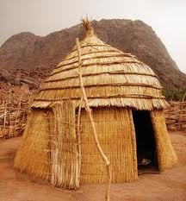
I. The Dumb Brothers Fell Prey to the Big Bad Wolf.
C. How do you fall prey to him?

Slide 24
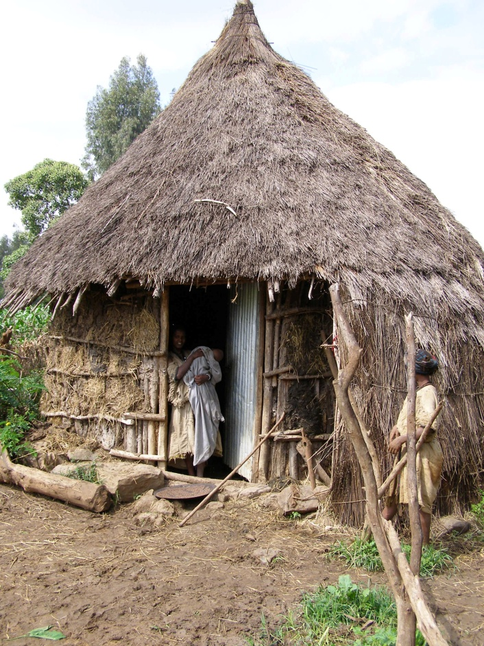
I. The Dumb Brothers Fell Prey to the Big Bad Wolf.
C. How do you fall prey to him?

Slide 25
I. The Dumb Brothers Fell Prey to the Big Bad Wolf.
C. How do you fall prey to him?
2. Houses like these are easy to blow down & wash away.
But everyone who hears these words of mine and does not put them into practice is like a foolish man who built his house on sand. The rain came down, the streams rose, and the winds blew and beat against that house, and it fell with a great crash. - v26-27

Slide 26
I. The Dumb Brothers Fell Prey to the Big Bad Wolf.
C. How do you fall prey to him?
a. It depends upon how seriously you accept the word of God.

Slide 27
I. The Dumb Brothers Fell Prey to the Big Bad Wolf.
Matthew 13:3-8 - A farmer went out to sow his seed. As he was scattering the seed, some fell along the path, and the birds came and ate it up. Some fell on rocky places, where it did not have much soil. It sprang up quickly, because the soil was shallow. But when the sun came up, the plants were scorched, and they withered because they had no root. Other seed fell among thorns, which grew up and choked the plants. Still other seed fell on good soil, where it produced a crop — a hundred, sixty or thirty times what was sown.

Slide 28
I. The Dumb Brothers Fell Prey to the Big Bad Wolf.
Matthew 13:19-22 - When anyone hears the message about the kingdom and does not understand it, the evil one comes and snatches away what was sown in his heart. This is the seed sown along the path. The one who received the seed that fell on rocky places is the man who hears the word and at once receives it with joy. But since he has no root, he lasts only a short time. When trouble or persecution comes because of the word, he quickly falls away. The one who received the seed that fell among the thorns is the man who hears the word, but the worries of this life and the deceitfulness of wealth choke it, making it unfruitful.

Slide 29
I. The Dumb Brothers Fell Prey to the Big Bad Wolf.
Matthew 13:19-22 - When anyone hears the message about the kingdom and does not understand it, the evil one comes and snatches away what was sown in his heart. This is the seed sown along the path. The one who received the seed that fell on rocky places is the man who hears the word and at once receives it with joy. But since he has no root, he lasts only a short time. When trouble or persecution comes because of the word, he quickly falls away. The one who received the seed that fell among the thorns is the man who hears the word, but the worries of this life and the deceitfulness of wealth choke it, making it unfruitful.

Slide 30
I. The Dumb Brothers Fell Prey to the Big Bad Wolf.
Matthew 13:19-22 - When anyone hears the message about the kingdom and does not understand it, the evil one comes and snatches away what was sown in his heart. This is the seed sown along the path. The one who received the seed that fell on rocky places is the man who hears the word and at once receives it with joy. But since he has no root, he lasts only a short time. When trouble or persecution comes because of the word, he quickly falls away. The one who received the seed that fell among the thorns is the man who hears the word, but the worries of this life and the deceitfulness of wealth choke it, making it unfruitful.

Slide 31
I. The Dumb Brothers Fell Prey to the Big Bad Wolf.
II. The Wise Piggy Conquered the Big Bad Wolf.

Slide 32
II. The Wise Piggy Conquered the Big Bad Wolf.
A. He chose the narrow road with the small gate.
Enter through the narrow gate . . . But small is the gate and narrow the road that leads to life, and only a few find it. - v13-14

Slide 33
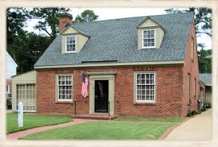
II. The Wise Piggy Conquered the Big Bad Wolf.
A. He chose the narrow road with the small gate.
1. He prepared himself by using bricks.

Slide 34
II. The Wise Piggy Conquered the Big Bad Wolf.
A. He chose the narrow road with the small gate.
1. He prepared himself by using bricks.
2. He didn’t obey the big bad wolf!

Slide 35
II. The Wise Piggy Conquered the Big Bad Wolf.
B. How can you fortify yourself against the big bad wolf?

Slide 36
II. The Wise Piggy Conquered the Big Bad Wolf.
B. How can you fortify yourself against the big bad wolf?
1. Make the right choice - Take the narrow road!
Enter through the narrow gate . . . But small is the gate and narrow the road that leads to life, and only a few find it. - v13-14

Slide 37
II. The Wise Piggy Conquered the Big Bad Wolf.
B. How can you fortify yourself against the big bad wolf?
2. Prepare your heart.
Matthew 13:8 & 23 - Still other seed fell on good soil, where it produced a crop — a hundred, sixty or thirty times what was sown . . . But the one who received the seed that fell on good soil is the man who hears the word and understands it. He produces a crop, yielding a hundred, sixty or thirty times what was sown.”

Slide 38
II. The Wise Piggy Conquered the Big Bad Wolf.
B. How can you fortify yourself against the big bad wolf?
3. Continue hearing & practicing the word of God.
Therefore everyone who hears these words of mine and puts them into practice is like a wise man who built his house on the rock. The rain came down, the streams rose, and the winds blew and beat against that house; yet it did not fall, because it had its foundation on the rock. - v24-25

Slide 39
II. The Wise Piggy Conquered the Big Bad Wolf.
B. How can you fortify yourself against the big bad wolf?
4. By obeying God’s word you can withstand the big bad wolf!
Romans 8:38-39 - For I am convinced that neither death nor life, neither angels nor demons, neither the present nor the future, nor any powers, neither height nor depth, nor anything else in all creation, will be able to separate us from the love of God that is in Christ Jesus our Lord.

Slide 40
II. The Wise Piggy Conquered the Big Bad Wolf.
B. How can you fortify yourself against the big bad wolf?
5. God’s word warns . . .
Do not merely listen to the word, and so deceive yourselves. Do what it says. - James 1:22

Slide 41
Which piggy are you? Are you like the dumb brothers who heard but did not obey?
Are you like the smart piggy who built his life upon the solid foundation of obedience to the word of God?

