Slide 1
the evidence of your salvation

Slide 2
How do you know
if God has saved you?
Ephesians 2:8-9 - For it is by grace you have been saved, through faith — and this not from yourselves, it is the gift of God — not by works, so that no one can boast.

Slide 3
How do you know
if God has saved you?
Ephesians 2:8-9 - For it is by grace you have been saved, through faith — and this not from yourselves, it is the gift of God — not by works, so that no one can boast.
Acts 2:38 - Peter replied, “Repent and be baptized, every one of you, in the name of Jesus Christ for the forgiveness of your sins. And you will receive the gift of the Holy Spirit.

Slide 4
I John 4:7-9
Dear friends, let us love one another, for love comes from God. Everyone who loves has been born of God and knows God. Whoever does not love does not know God, because God is love. This is how God showed his love among us: He sent his one and only Son into the world that we might live through him.

Slide 5
I John 4:10-12
This is love: not that we loved God, but that he loved us and sent his Son as an atoning sacrifice for our sins. Dear friends, since God so loved us, we also ought to love one another. No one has ever seen God; but if we love one another, God lives in us and his love is made complete in us.

Slide 6
I John 4:13-15
We know that we live in him and he in us, because he has given us of his Spirit. And we have seen and testify that the Father has sent his Son to be the Savior of the world. If anyone acknowledges that Jesus is the Son of God, God lives in him and he in God.

Slide 7
What is the evidence
that salvation is really happening?

Slide 8
What is the evidence
that salvation is really happening?
Dear friends, since God so loved us, we also ought to love one another. - v11

Slide 9
“Oh, How I Love Jesus.”
I am so glad that our Father in heaven
Tells of His love in the book He has given;
Wonderful things in the Bible I see --
This is the dearest, that Jesus loves me!
Though I forget Him and wander away,
Still He does love me wherever I stray;
Back to His dear loving arms would I flee
When I remember that Jesus loves me!

Slide 10
Where does this love come from?
What makes it an evidence of your salvation?

Slide 11
I. Where Does This Love Come From?- v7-12

Slide 12
I. Where Does This Love Come From?
A. Love begins with God.
Dear friends, let us love one another, for love comes from God. Everyone who loves has been born of God and knows God. Whoever does not love does not know God, because God is love. - v7-8

Slide 13
I. Where Does This Love Come From?
A. Love begins with God.
1. This explains why God created us.

Slide 14
I. Where Does This Love Come From?
A. Love begins with God.
1. This explains why God created us.
Love needs an object - you!

Slide 15
I. Where Does This Love Come From?
A. Love begins with God.
2. This explains why God gave you free will.

Slide 16
I. Where Does This Love Come From?
A. Love begins with God.
2. This explains why God gave you free will.
God created evil - your choice!

Slide 17
I. Where Does This Love Come From?
A. Love begins with God.
3. This explains why God has such an interest in His creation.

Slide 18
I. Where Does This Love Come From?
A. Love begins with God.
3. This explains why God has such an interest in His creation.
a. The Deist Position: create us & then leave us alone.

Slide 19
I. Where Does This Love Come From?
A. Love begins with God.
3. This explains why God has such an interest in His creation.
a. The Deist Position: create us & then leave us alone.
b. But - God prefers to work in & through your life!

Slide 20
I. Where Does This Love Come From?
A. Love begins with God.
4. This explains why God allowed the cross!

Slide 21
I. Where Does This Love Come From?
A. Love begins with God.
4. This explains why God allowed the cross!
a. Without love.
Romans 6:23 - For the wages of sin is death.

Slide 22
I. Where Does This Love Come From?
A. Love begins with God.
4. This explains why God allowed the cross!
b. With love.
John 3:16 - For God so loved the world that he gave his one and only Son, that whoever believes in him shall not perish but have eternal life.

Slide 23
I. Where Does This Love Come From?
B. Love was made known through Jesus.
This is how God showed his love among us: He sent his one and only Son into the world that we might live through him. This is love: not that we loved God, but that he loved us and sent his Son as an atoning sacrifice for our sins. - v9-10

Slide 24
I. Where Does This Love Come From?
B. Love was made known through Jesus.
This is how God showed his love among us: He sent his one and only Son into the world that we might live through him. This is love: not that we loved God, but that he loved us and sent his Son as an atoning sacrifice for our sins. - v9-10
1. He was the bringer of real life.

Slide 25
I. Where Does This Love Come From?
B. Love was made known through Jesus.
. . . he loved us and sent his Son as an atoning sacrifice for our sins. - v9-10
2. He was the restorer of your lost relationship with God.
Romans 5:8 - But God demonstrates his own love for us in this: While we were still sinners, Christ died for us.

Slide 26
I. Where Does This Love Come From?
B. Love was made known through Jesus.
. . . he loved us and sent his Son as an atoning sacrifice for our sins. - v9-10
2. He was the restorer of your lost relationship with God.
b. Atoning sacrifice * = lit. “mercy seat”.
* ἱλασμός

Slide 27
I. Where Does This Love Come From?
C. Love is displayed to the world through us!
No one has ever seen God; but if we love one another, God lives in us and his love is made complete in us. - v12

Slide 28
I. Where Does This Love Come From?
C. Love is displayed to the world through us!
No one has ever seen God; but if we love one another, God lives in us and his love is made complete in us. - v12
1. Live in * = abide, remain, dwell.
* μένω

Slide 29
I. Where Does This Love Come From?
C. Love is displayed to the world through us!
No one has ever seen God; but if we love one another, God lives in us and his love is made complete in us. - v12
2. Complete * = to make perfect, become mature.
* τελειόω

Slide 30
I. Where Does This Love Come From?- v7-12
II. How Does Love Become the Evidence of Your Salvation? - v13-15

Slide 31
II. How Does Love Become
the Evidence of Your Salvation?
A. Love comes “of His Spirit”.
We know that we live in him and he in us, because he has given us of his Spirit. - v13

Slide 32
II. How Does Love Become
the Evidence of Your Salvation?
A. Love comes “of His Spirit”.
We know that we live in him and he in us, because he has given us of his Spirit. - v13
Romans 5:5 - God has poured out his love into our hearts by the Holy Spirit, whom he has given us.

Slide 33
II. How Does Love Become
the Evidence of Your Salvation?
A. Love comes “of His Spirit”.
We know that we live in him and he in us, because he has given us of his Spirit. - v13
1. Love is the first fruit of the Spirit.
Galatians 5:22 - But the fruit of the Spirit is love, joy, peace, patience, kindness, goodness, faithfulness, gentleness and self-control. Against such things there is no law.

Slide 34
II. How Does Love Become
the Evidence of Your Salvation?
A. Love comes “of His Spirit”.
We know that we live in him and he in us, because he has given us of his Spirit. - v13
2. Know * = to know by personal experience.
* γινώσκω

Slide 35
II. How Does Love Become
the Evidence of Your Salvation?
A. Love comes “of His Spirit”.
We know that we live in him and he in us, because he has given us of his Spirit. - v13
2. Know * = to know by personal experience.
You can know from experience that
you are remaining in Him &
He is remaining in you!
* γινώσκω

Slide 36
II. How Does Love Become
the Evidence of Your Salvation?
B. Love becomes the expression of an active faith.
And we have seen and testify that the Father has sent his Son to be the Savior of the world. If anyone acknowledges that Jesus is the Son of God, God lives in him and he in God. - v14-15

Slide 37
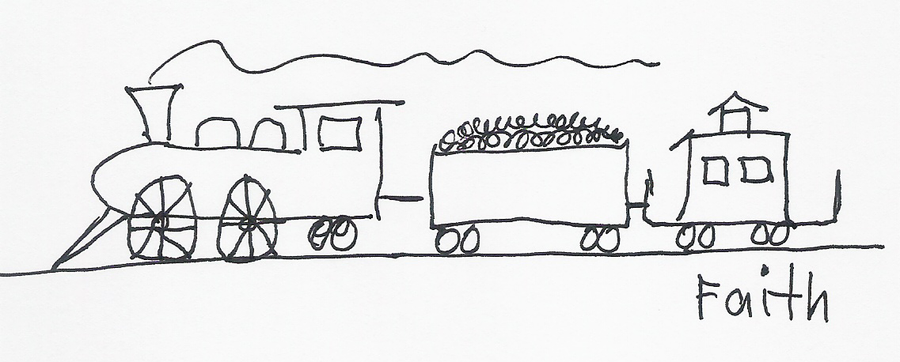
II. How Does Love Become
the Evidence of Your Salvation?
And we have seen and testify that the Father has sent his Son to be the Savior of the world. If anyone acknowledges that Jesus is the Son of God, God lives in him and he in God. - v14-15
1. Saving faith is trusting Jesus as the Son of God & your Savior.

Slide 38
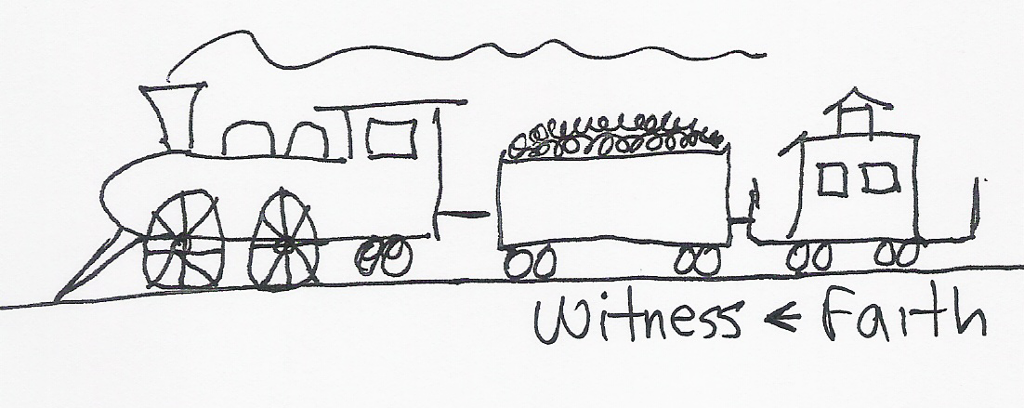
II. How Does Love Become
the Evidence of Your Salvation?
And we have seen and testify that the Father has sent his Son to be the Savior of the world. If anyone acknowledges that Jesus is the Son of God, God lives in him and he in God. - v14-15
2. Putting your faith into a verbal witness makes it alive!

Slide 39
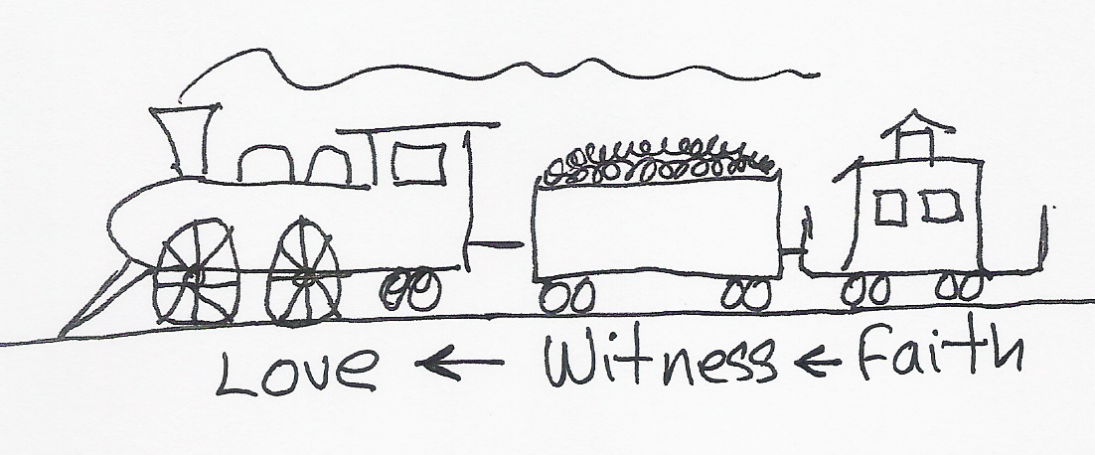
II. How Does Love Become
the Evidence of Your Salvation?
3. Putting your confession into an active love gives it power!

Slide 40
II. How Does Love Become
the Evidence of Your Salvation?
James 2:14-18 - What good is it, my brothers, if a man claims to have faith but has no deeds? Can such faith save him? Suppose a brother or sister is without clothes and daily food. If one of you says to him, “Go, I wish you well; keep warm and well fed,” but does nothing about his physical needs, what good is it? In the same way, faith by itself, if it is not accompanied by action, is dead. But someone will say, “You have faith; I have deeds.” Show me your faith without deeds, and I will show you my faith by what I do.

Slide 41
So - love becomes
the evidence of your salvation
when it’s coupled
to an active faith!

