Slide 1
How to Deal with Desires

Slide 2
1. We don’t know what we really want because we are not focused on what really counts!

Slide 3
1. We don’t know what we really want because we are not focused on what really counts!
Genesis 3:1-6

Slide 4
2. So how does God want you to deal with your desires?

Slide 5
James 4:1-3
What causes fights and quarrels among you? Don’t they come from your desires that battle within you? You want something but don’t get it. You kill and covet, but you cannot have what you want. You quarrel and fight. You do not have, because you do not ask God. When you ask, you do not receive, because you ask with wrong motives, that you may spend what you get on your pleasures.

Slide 6
James 4:4-6
You adulterous people, don’t you know that friendship with the world is hatred toward God? Anyone who chooses to be a friend of the world becomes an enemy of God. Or do you think Scripture says without reason that the spirit he caused to live in us envies intensely? But he gives us more grace. That is why Scripture says: “God opposes the proud but gives grace to the humble.”

Slide 7
James 4:7-10
Submit yourselves, then, to God. Resist the devil, and he will flee from you. Come near to God and he will come near to you. Wash your hands, you sinners, and purify your hearts, you double-minded. Grieve, mourn and wail. Change your laughter to mourning and your joy to gloom. Humble yourselves before the Lord, and he will lift you up.

Slide 8
I. How You Do It Wrong - v1-3

Slide 9
I. How You Do It Wrong.
A. The “Dog Eat Dog” way.
You want something but don’t get it. You kill and covet, but you cannot have what you want. You quarrel and fight. You do not have, because you do not ask God. - v2

Slide 10
I. How You Do It Wrong.
A. The “Dog Eat Dog” way.
You want something but don’t get it. You kill and covet, but you cannot have what you want. You quarrel and fight. You do not have, because you do not ask God. - v2
1. You try whatever it takes to get you to the top.

Slide 11
I. How You Do It Wrong.
A. The “Dog Eat Dog” way.
You want something but don’t get it. You kill and covet, but you cannot have what you want. You quarrel and fight. You do not have, because you do not ask God. - v2
2. But no matter what you obtain it never really satisfies!
Why?

Slide 12
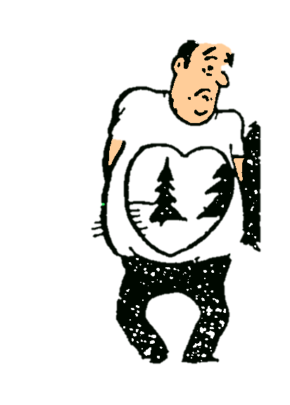
I. How You Do It Wrong.
A. The “Dog Eat Dog” way.
You want something but don’t get it. You kill and covet, but you cannot have what you want. You quarrel and fight. You do not have, because you do not ask God. - v2

Slide 13
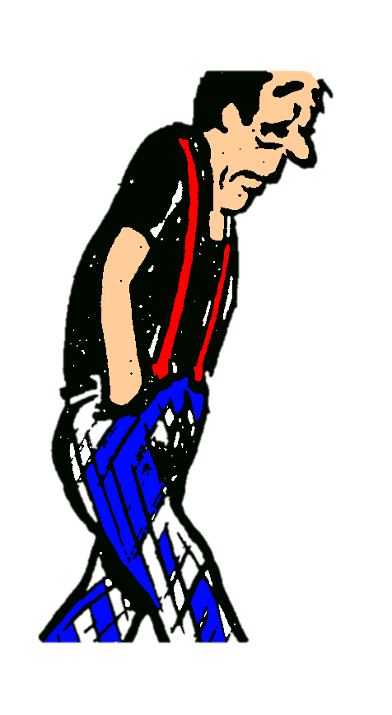
I. How You Do It Wrong.
A. The “Dog Eat Dog” way.
You want something but don’t get it. You kill and covet, but you cannot have what you want. You quarrel and fight. You do not have, because you do not ask God. - v2

Slide 14
I. How You Do It Wrong.
A. The “Dog Eat Dog” way.
You want something but don’t get it. You kill and covet, but you cannot have what you want. You quarrel and fight. You do not have, because you do not ask God. - v2

Slide 15
I. How You Do It Wrong.
B. How do you fill that emptiness?

Slide 16
I. How You Do It Wrong.
B. How do you fill that emptiness?
You do not have, because you do not ask God. When you ask, you do not receive, because you ask with wrong motives, that you may spend what you get on your pleasures. - v2-3
1. Asking God is the only way to fill the empty vacuum with fulfillment.

Slide 17
I. How You Do It Wrong.
B. How do you fill that emptiness?
You do not have, because you do not ask God. When you ask, you do not receive, because you ask with wrong motives, that you may spend what you get on your pleasures. - v2-3
2. But - you ask Him with selfish desires.

Slide 18
I. How You Do It Wrong.
B. How do you fill that emptiness?
You do not have, because you do not ask God. When you ask, you do not receive, because you ask with wrong motives, that you may spend what you get on your pleasures. - v3
3. Criteria for answered prayer:

Slide 19
I. How You Do It Wrong.
B. How do you fill that emptiness?
a. What is within the scope of His will for you?
II Corinthians 12:8-10 - Three times I pleaded with the Lord to take it away from me. But he said to me, “My grace is sufficient for you, for my power is made perfect in weakness.” Therefore I will boast all the more gladly about my weaknesses, so that Christ’s power may rest on me. That is why, for Christ’s sake, I delight in weaknesses, in insults, in hardships, in persecutions, in difficulties. For when I am weak, then I am strong.

Slide 20
I. How You Do It Wrong.
B. How do you fill that emptiness?
b. What is really in your best interests?
Romans 8:28 - And we know that in all things God works for the good of those who love him, who have been called according to his purpose.

Slide 21
I. How You Do It Wrong - v1-3
II. Why You Do It Wrong - v4-6

Slide 22
II. Why You Do It Wrong.
A. The Surface Cause.

Slide 23
II. Why You Do It Wrong.
A. The Surface Cause.
Your loyalty is to the ways of this world instead of the ways of God.
You adulterous people, don’t you know that friendship with the world is hatred toward God? Anyone who chooses to be a friend of the world becomes an enemy of God. - v4

Slide 24
II. Why You Do It Wrong.
B. The Root Cause.
Or do you think Scripture says without reason that the spirit he caused to live in us envies intensely? But he gives us more grace. That is why Scripture says: “God opposes the proud but gives grace to the humble.” - v5-6

Slide 25
II. Why You Do It Wrong.
B. The Root Cause.
Or do you think Scripture says without reason that the spirit he caused to live in us envies intensely? But he gives us more grace. That is why Scripture says: “God opposes the proud but gives grace to the humble.”- v5-6
Proverbs 3:34 - He mocks proud mockers but gives grace to the humble.

Slide 26
I. How You Do It Wrong - v1-3
II. Why You Do It Wrong - v4-6
III. How To Do It Right - v7-10

Slide 27
III. How To Do It Right.
A. The Five Steps to returning to a victorious life!

Slide 28
III. How To Do It Right.
A. The Five Steps to returning to a victorious life!
1. Step 1 - Submit to God.
Submit yourselves, then, to God. Resist the devil, and he will flee from you. - v7

Slide 29
III. How To Do It Right.
A. The Five Steps to returning to a victorious life!
1. Step 1 - Submit to God.
Submit yourselves, then, to God. Resist the devil, and he will flee from you. - v7
Submit * = arrange yourself underneath someone else’ authority. ∗ ὑποτάσσω

Slide 30
III. How To Do It Right.
A. The Five Steps to returning to a victorious life!
2. Step 2 - Resist the devil.
Submit yourselves, then, to God. Resist the devil, and he will flee from you.- v7

Slide 31
III. How To Do It Right.
A. The Five Steps to returning to a victorious life!
2. Step 2 - Resist the devil.
Submit yourselves, then, to God. Resist the devil, and he will flee from you.- v7
Ephesians 2:2

Slide 32
III. How To Do It Right.
A. The Five Steps to returning to a victorious life!
2. Step 2 - Resist the devil.
Submit yourselves, then, to God. Resist the devil, and he will flee from you.- v7
I Peter 5:8-9 - Be self-controlled and alert. Your enemy the devil prowls around like a roaring lion looking for someone to devour. Resist him, standing firm in the faith . . .

Slide 33
III. How To Do It Right.
A. The Five Steps to returning to a victorious life!
2. Step 2 - Resist the devil.
Submit yourselves, then, to God. Resist the devil, and he will flee from you. - v7

Slide 34
III. How To Do It Right.
A. The Five Steps to returning to a victorious life!
3. Step 3 - Come near to God.
Come near to God and he will come near to you. Wash your hands, you sinners, and purify your hearts, you double-minded. - v8

Slide 35
III. How To Do It Right.
A. The Five Steps to returning to a victorious life!
4. Step 4 - Wash & Purify.
Come near to God and he will come near to you. Wash your hands, you sinners, and purify your hearts, you double-minded.- v8

Slide 36
III. How To Do It Right.
A. The Five Steps to returning to a victorious life!
5. Step 5 - Grieve by repenting.
Grieve, mourn and wail. Change your laughter to mourning and your joy to gloom. - v9

Slide 37
III. How To Do It Right.
B. Change your desires to God’s desires.

Slide 38
III. How To Do It Right.
Forsake the world & its ways.
Cling to God & His ways.
Give up your pride & humbly surrender to Him!

