Slide 1
what does a living sacrifice involve?

Slide 2
Being a Christian means consecration!
Carrying the cross means
commitment to it!
Matthew 16:24 - Then Jesus said to his disciples, “If anyone would come after me, he must deny himself and take up his cross and follow me.

Slide 3
Romans 12:1-2
Therefore, I urge you, brothers, in view of God’s mercy, to offer your bodies as living sacrifices, holy and pleasing to God — this is your spiritual act of worship. Do not conform any longer to the pattern of this world, but be transformed by the renewing of your mind. Then you will be able to test and approve what God’s will is — his good, pleasing and perfect will.

Slide 4
I. What is Sacrificed?

Slide 5
I. What is Sacrificed?
A. It’s not an Old Testament animal blood sacrifice, but your own bodies!

Slide 6
I. What is Sacrificed?
A. It’s not an Old Testament animal blood sacrifice, but your own bodies!
1. An example of blood sacrifice:
The Day of Atonement (Yom Kipper).
(Leviticus 16:2-34)

Slide 7
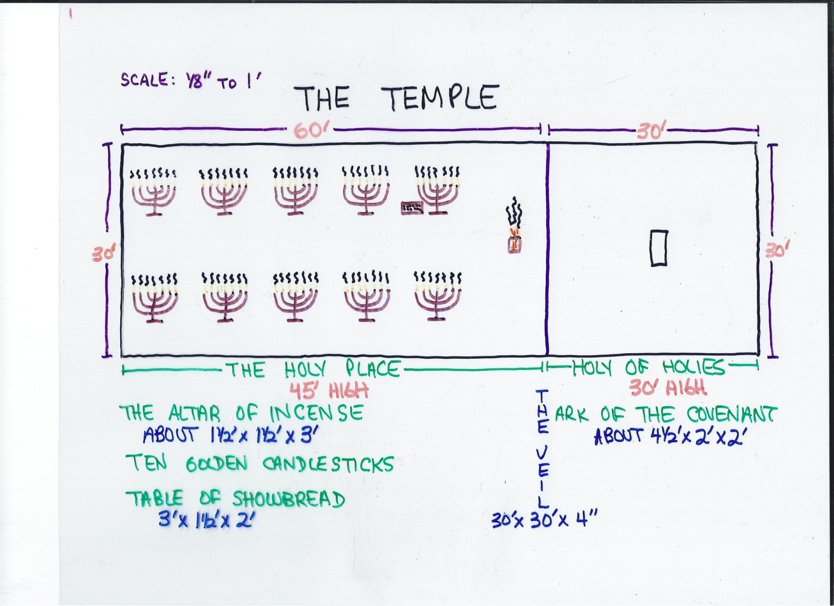

Slide 8
I. What is Sacrificed?
1. An example of blood sacrifice:
The Day of Atonement (Yom Kipper).
Leviticus 16:6 - Aaron is to offer the bull for his own sin offering to make atonement for himself and his household.

Slide 9
I. What is Sacrificed?
Leviticus 16:15, 21-22 - He shall then slaughter the goat for the sin offering for the people and take its blood behind the curtain and do with it as he did with the bull’s blood: He shall sprinkle it on the atonement cover and in front of it . . . He is to lay both hands on the head of the live goat and confess over it all the wickedness and rebellion of the Israelites — all their sins — and put them on the goat’s head. He shall send the goat away into the desert in the care of a man appointed for the task. The goat will carry on itself all their sins to a solitary place; and the man shall release it in the desert.

Slide 10
I. What is Sacrificed?
1. An example of blood sacrifice:
The Day of Atonement (Yom Kipper).
2. An example of God’s unlimited love: The Day of Passover.

Slide 11
I. What is Sacrificed?
Jesus went to the cross to become your perfect . . .
a. High Priest.
Hebrews 5:5-6 - So Christ also did not take upon himself the glory of becoming a high priest. But God said to him, “You are my Son; today I have become your Father.” And he says in another place, “You are a priest forever, in the order of Melchizedek.”

Slide 12
I. What is Sacrificed?
Jesus went to the cross to become your perfect . . .
b. Sacrifice.
Colossians 1:20-22 - and through him to reconcile to himself all things, whether things on earth or things in heaven, by making peace through his blood, shed on the cross. Once you were alienated from God and were enemies in your minds because of your evil behavior. But now he has reconciled you by Christ’s physical body through death to present you holy in his sight, without blemish and free from accusation.

Slide 13
I. What is Sacrifice?
Jesus went to the cross to become your perfect . . .
c. Scapegoat.
John 11:49-50 - Then one of them, named Caiaphas, who was high priest that year, spoke up, “You know nothing at all! You do not realize that it is better for you that one man die for the people than that the whole nation perish.”

Slide 14
I. What is Sacrificed?
1. An example of blood sacrifice:
The Day of Atonement (Yom Kipper).
2. An example of God’s unlimited love: The Day of Passover.
3. The Day of Your Personal Decision.

Slide 15
I. What is Sacrificed?
When you surrender your heart to the Lord, you become . . .
a. A priest.
I Peter 2:5 - You also, like living stones, are being built into a spiritual house to be a holy priesthood, offering spiritual sacrifices acceptable to God through Jesus Christ.

Slide 16
I. What is Sacrificed?
When you surrender your heart to the Lord, you become . . .
b. A living sacrifice.
Therefore, I urge you, brothers, in view of God’s mercy, to offer your bodies as living sacrifices, holy and pleasing to God — this is your spiritual act of worship. - v1
I Corinthians 6:13 - The body is not meant for sexual immorality, but for the Lord, and the Lord for the body.

Slide 17
I. What is Sacrificed?
A. It’s not an Old Testament animal blood sacrifice, but your own bodies!
B. What does this sacrifice involve?

Slide 18
I. What is Sacrificed?
B. What does this sacrifice involve?
Therefore, I urge you, brothers, in view of God’s mercy, to offer your bodies as living sacrifices, holy and pleasing to God — this is your spiritual act of worship. - v1
1. It’s to be living, not dead.
I Corinthians 6:19-20 - Do you not know that your body is a temple of the Holy Spirit, who is in you, whom you have received from God? You are not your own; ﻿you were bought at a price. Therefore honor God with your body.

Slide 19
I. What is Sacrificed?
B. What does this sacrifice involve?
Therefore, I urge you, brothers, in view of God’s mercy, to offer your bodies as living sacrifices, holy and pleasing to God — this is your spiritual act of worship. - v1
2. It’s to be holy (sacred), not ritualistic.

Slide 20
I. What is Sacrificed?
B. What does this sacrifice involve?
Therefore, I urge you, brothers, in view of God’s mercy, to offer your bodies as living sacrifices, holy and pleasing to God — this is your spiritual act of worship. - v1
3. It’s to be well pleasing to God, not just blind obedience to rules.

Slide 21
I. What is Sacrificed?
II. Why Make This Sacrifice?

Slide 22
II. Why Make This Sacrifice?
A. Because God gave you this opportunity to show your gratitude.
Therefore, I urge you, brothers, in view of God’s mercy, to offer your bodies as living sacrifices, holy and pleasing to God — this is your spiritual act of worship. - v1

Slide 23
II. Why Make This Sacrifice?
A. Because God gave you this opportunity to show your gratitude.
Therefore, I urge you, brothers, in view of God’s mercy, to offer your bodies as living sacrifices, holy and pleasing to God — this is your spiritual act of worship. - v1
1. Mercy * = compassion.
* οiκτιρμός

Slide 24
II. Why Make This Sacrifice?
A. Because God gave you this opportunity to show your gratitude.
Therefore, I urge you, brothers, in view of God’s mercy, to offer your bodies as living sacrifices, holy and pleasing to God — this is your spiritual act of worship. - v1
2. How was it expressed?
On the cross!

Slide 25
II. Why Make This Sacrifice?
B. Because it is your spiritual act of worship.
Therefore, I urge you, brothers, in view of God’s mercy, to offer your bodies as living sacrifices, holy and pleasing to God — this is your spiritual act of worship. - v1

Slide 26
II. Why Make This Sacrifice?
B. Because it is your spiritual act of worship.
Therefore, I urge you, brothers, in view of God’s mercy, to offer your bodies as living sacrifices, holy and pleasing to God — this is your spiritual act of worship. - v1
1. Spiritual act of worship * = reasonable, “logical” service.
* τὴν λογικὴν λατρείαν ὑμω̂ν

Slide 27
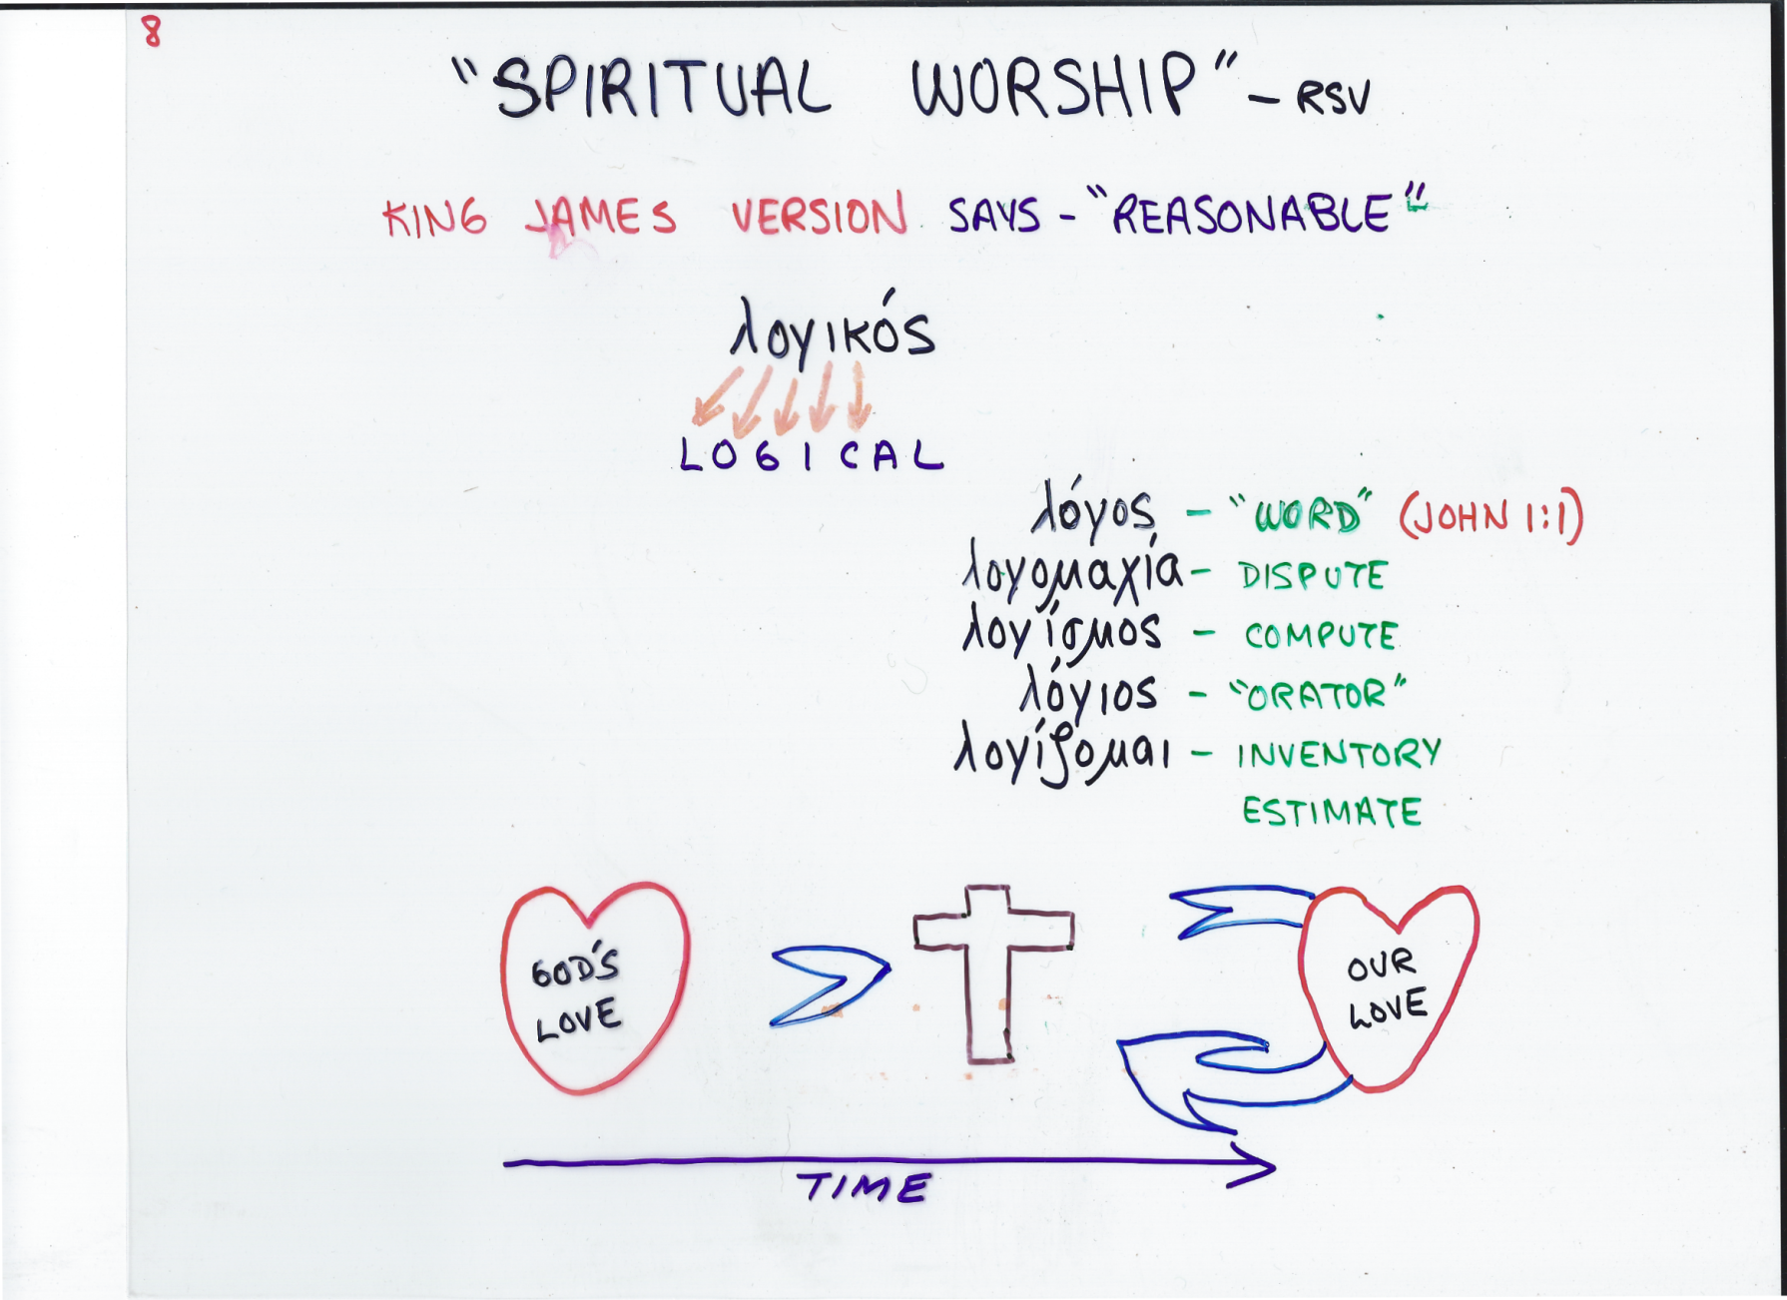
II. Why Make This Sacrifice?

Slide 28
II. Why Make This Sacrifice?
B. Because it is your spiritual act of worship.
2. God gave His Only Son for you, it’s only logical that you give yourself back to God!

Slide 29
II. Why Make This Sacrifice?
B. Because it is your spiritual act of worship.
2. God gave His Only Son for you, it’s only logical that you give yourself back to God!
Ephesians 5:8, 10 - For you were once dark-ness, but now you are light in the Lord. Live as children of light . . . ﻿and find out what pleases the Lord.

Slide 30
II. Why Make This Sacrifice?
C. Because your life of obedience can be approved.
Do not conform any longer to the pattern of this world, but be transformed by the renewing of your mind. Then you will be able to test and approve what God’s will is — his good, pleasing and perfect will. – v2

Slide 31
II. Why Make This Sacrifice?
James 2:14-18 - What good is it, my brothers, if a man claims to have faith but has no deeds? Can such faith save him? Suppose a brother or sister is without clothes and daily food. If one of you says to him, “Go, I wish you well; keep warm and well fed,” but does nothing about his physical needs, what good is it? In the same way, faith by itself, if it is not accompanied by action, is dead. But someone will say, “You have faith; I have deeds.” Show me your faith without deeds, and I will show you my faith by what I do.

Slide 32
I. What is Sacrificed?
II. Why Make This Sacrifice?
III. How Can I Make This Sacrifice?

Slide 33
III. How Can I Make This Sacrifice?
I Peter 1:14-16 - As obedient children, do not conform to the evil desires you had when you lived in ignorance. But just as he who called you is holy, so be holy in all you do; for it is written: “Be holy, because I am holy.”

Slide 34
III. How Can I Make This Sacrifice?
Do not conform any longer to the pattern of this world, but be transformed by the renewing of your mind. Then you will be able to test and approve what God’s will is — his good, pleasing and perfect will. – v2
A. It can’t be done by changing yourself outwardly.

Slide 35
III. How Can I Make This Sacrifice?
Do not conform any longer to the pattern of this world, but be transformed by the renewing of your mind. Then you will be able to test and approve what God’s will is — his good, pleasing and perfect will. – v2
A. It can’t be done by changing yourself outwardly.
1. Conform * = become a copy of.
* συσχηματίζω

Slide 36
III. How Can I Make This Sacrifice?
A. It can’t be done by changing yourself outwardly.
2. What does the Bible say about identifying with the world?

Slide 37
III. How Can I Make This Sacrifice?
2. What does the Bible say about identifying with the world?
I John 2:15-16 - Do not love the world or anything in the world. If anyone loves the world, the love of the Father is not in him. For everything in the world — the cravings of sinful man, the lust of his eyes and the boasting of what he has and does — comes not from the Father but from the world.

Slide 38
III. How Can I Make This Sacrifice?
Do not conform any longer to the pattern of this world, but be transformed by the renewing of your mind. Then you will be able to test and approve what God’s will is — his good, pleasing and perfect will. – v2
A. It can’t be done by changing yourself outwardly.
B. It must be done by allowing the gospel to transform your mind.

Slide 39
III. How Can I Make This Sacrifice?
Do not conform any longer to the pattern of this world, but be transformed by the renewing of your mind. Then you will be able to test and approve what God’s will is — his good, pleasing and perfect will. – v2
B. It must be done by allowing the gospel to transform your mind.
1. Transform * = to transfigure, change into another form, lit., “metamorphosis”.
* μεταμορφόω

Slide 40
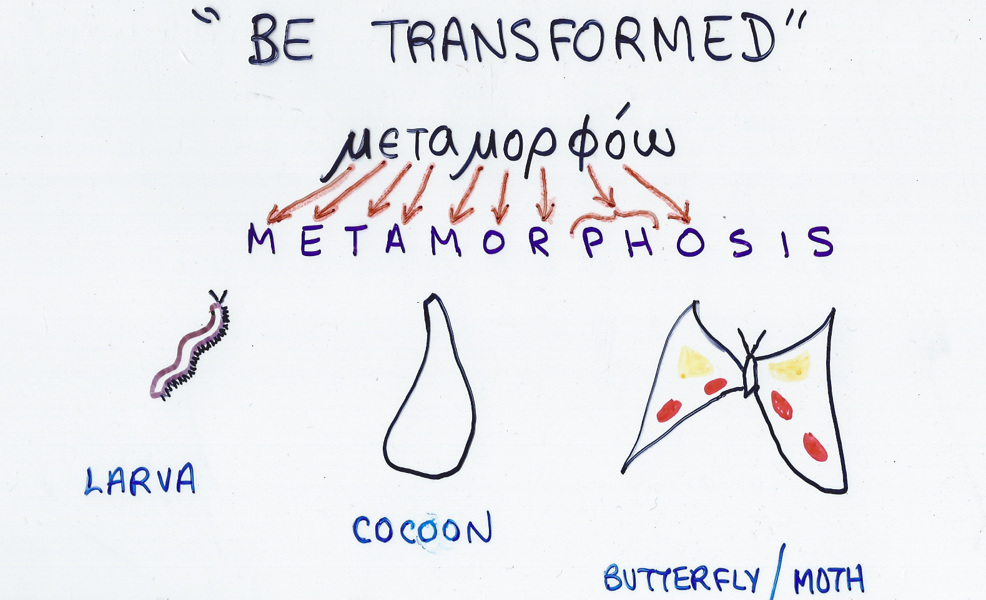
III. How Can I Make This Sacrifice?

Slide 41
III. How Can I Make This Sacrifice?
2. Used 4 times in the New Testament.

Slide 42
III. How Can I Make This Sacrifice?
2. Used 4 times in the New Testament.
Do not conform any longer to the pattern of this world, but be transformed by the renewing of your mind. Then you will be able to test and approve what God’s will is — his good, pleasing and perfect will. – v2

Slide 43
III. How Can I Make This Sacrifice?
2. Used 4 times in the New Testament.
The Lord’s Transfiguration
Matthew 17:2 & Mark 9:2

Slide 44
III. How Can I Make This Sacrifice?
2. Used 4 times in the New Testament.
II Corinthians 3:18 - And we, who with unveiled faces all reflect the Lord’s glory, are being transformed into his likeness with ever-increasing glory, which comes from the Lord, who is the Spirit.

Slide 45
III. How Can I Make This Sacrifice?
Do not conform any longer to the pattern of this world, but be transformed by the renewing of your mind. Then you will be able to test and approve what God’s will is — his good, pleasing and perfect will. – v2
3. These changes begin to take place when you renew your mind.

Slide 46
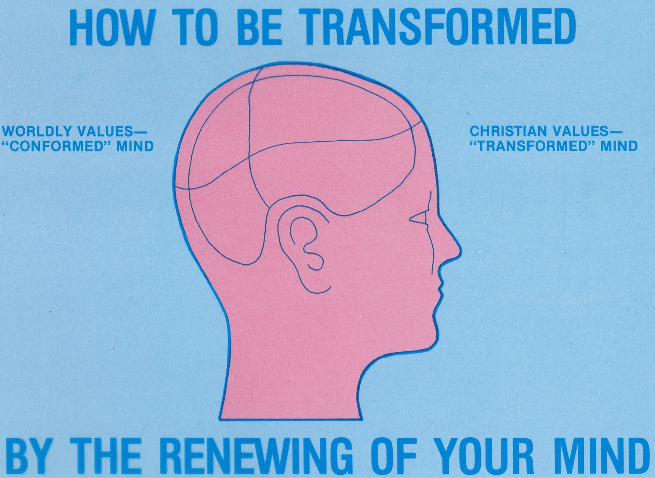
III. How Can I Make This Sacrifice?

Slide 47
III. How Can I Make This Sacrifice?
Ephesians 1:18 - I pray also that the eyes of your heart may be enlightened in order that you may know the hope to which he has called you, the riches of his glorious inheritance in the saints . . .
3. These changes begin to take place when you renew your mind.

Slide 48
It’s a life of challenge!
It’s a life of commitment!
When you do
- you find the victorious life -
the life God planned for
you to have!

