Slide 1
how is spiritual fruit produced in your life?

Slide 2
John 15:1-4
I am the true vine, and my Father is the gardener. He cuts off every branch in me that bears no fruit, while every branch that does bear fruit he prunes so that it will be even more fruitful. You are already clean because of the word I have spoken to you. Remain in me, and I will remain in you. No branch can bear fruit by itself; it must remain in the vine. Neither can you bear fruit unless you remain in me.

Slide 3
John 15:5-8
I am the vine; you are the branches. If a man remains in me and I in him, he will bear much fruit; apart from me you can do nothing. If anyone does not remain in me, he is like a branch that is thrown away and withers; such branches are picked up, thrown into the fire and burned. If you remain in me and my words remain in you, ask whatever you wish, and it will be given you. This is to my Father’s glory, that you bear much fruit, showing yourselves to be my disciples.

Slide 4
John 15:9-11
As the Father has loved me, so have I loved you. Now remain in my love. If you obey my commands, you will remain in my love, just as I have obeyed my Father’s commands and remain in his love. I have told you this so that my joy may be in you and that your joy may be complete.

Slide 5
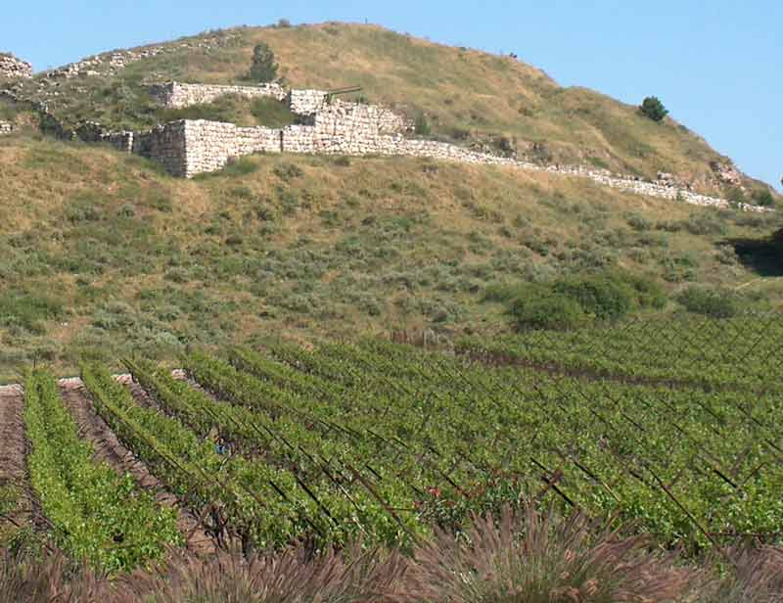
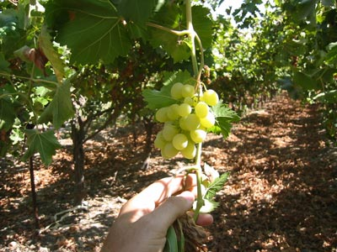

Slide 6
A branch must either remain connected to the vine or be grafted in to produce fruit!

Slide 7
I. What is the Symbolism of the Vine?

Slide 8
I. What is the Symbolism of the Vine?
A. What is the vine?
1. It was the symbol of Israel.

Slide 9
I. What is the Symbolism of the Vine?
A. What is the vine?
2. The Lord claimed to be the root vine stock.
I am the true vine . . . - v1

Slide 10
I. What is the Symbolism of the Vine?
A. What is the vine?
2. The Lord claimed to be the root vine stock.
a. Planted by God.
Matthew 1:20 - But after he had considered this, an angel of the Lord appeared to him in a dream and said, “Joseph son of David, do not be afraid to take Mary home as your wife, because what is conceived in her is from the Holy Spirit”.

Slide 11
I. What is the Symbolism of the Vine?
A. What is the vine?
2. The Lord claimed to be the root vine stock.
b. Cared for by God.
Matthew 4:11 - Then the devil left him, and angels came and attended him.
Luke 4:29-30 - They got up, drove him out of the town, and took him to the brow of the hill on which the town was built, in order to throw him down the cliff. But he walked right through the crowd and went on his way.

Slide 12
I. What is the Symbolism of the Vine?
B. Who are the branches?

Slide 13
I. What is the Symbolism of the Vine?
B. Who are the branches?
I am the vine; you are the branches. - v5

Slide 14
I. What is the Symbolism of the Vine?
B. Who are the branches?
1. The Jews were the original branches - but they didn’t produce!
Isaiah 5:1-7 - Jeremiah 2:21 -
Hosea 10:1 - Psalm 80:8

Slide 15
I. What is the Symbolism of the Vine?
B. Who are the branches?
2. You must be attached to be fruitful!
No branch can bear fruit by itself; it must remain in the vine. - v4

Slide 16
I. What is the Symbolism of the Vine?
C. What is the graft that binds you to the vine?

Slide 17
I. What is the Symbolism of the Vine?
C. What is the graft that binds you to the vine?
1. The spiritual grafting wax is love.
As the Father has loved me, so have I loved you. Now remain in my love. - v9

Slide 18
I. What is the Symbolism of the Vine?
C. What is the graft that binds you to the vine?
1. The spiritual grafting wax is love. - v9
John 17:26 - I have made you known to them, and will continue to make you known in order that the love you have for me may be in them and that I myself may be in them.

Slide 19
I. What is the Symbolism of the Vine?
C. What is the graft that binds you to the vine?
1. The spiritual grafting wax is love. - v9
John 17:26 - I have made you known to them, and will continue to make you known in order that the love you have for me may be in them and that I myself may be in them.
John 3:16 - For God so loved the world that he gave his one and only Son . . .

Slide 20
I. What is the Symbolism of the Vine?
C. What is the graft that binds you to the vine?
1. The spiritual grafting wax is love. - v9
Matthew 5:44 - But I tell you: Love your enemies and pray for those who persecute you.

Slide 21
I. What is the Symbolism of the Vine?
C. What is the graft that binds you to the vine?
2. The spiritual grafting wax is obedience.
If you obey my commands, you will remain in my love, just as I have obeyed my Father’s commands and remain in his love. - v10
I John 3:24 - Those who obey his commands live in him, and he in them. And this is how we know that he lives in us: We know it by the Spirit he gave us.

Slide 22
I. What is the Symbolism of the Vine?
C. What is the graft that binds you to the vine?
3. The spiritual grafting wax is joy.
I have told you this so that my joy may be in you and that your joy may be complete. - v11

Slide 23
I. What is the Symbolism of the Vine?
C. What is the graft that binds you to the vine?
3. The spiritual grafting wax is joy.
Acts 8:39 - When they came up out of the water, the Spirit of the Lord suddenly took Philip away, and the eunuch did not see him again, but went on his way rejoicing.

Slide 24
I. What is the Symbolism of the Vine?
C. What is the graft that binds you to the vine?
3. The spiritual grafting wax is joy.
Acts 5:41 - The apostles left the Sanhedrin, rejoicing because they had been counted worthy of suffering disgrace for the Name.

Slide 25
I. What is the Symbolism of the Vine?
II. What Does It Mean to Remain in Christ?

Slide 26
II. What Does It Mean to Remain in Christ?
A. Remain * = to abide, live in or to continue to be present in.
* μένω

Slide 27
II. What Does It Mean to Remain in Christ?
B. You are responsible to remain in my love - v9

Slide 28
II. What Does It Mean to Remain in Christ?
B. You are responsible to remain in my love - v9
Hebrews 6:4-6 - It is impossible for those who have once been enlightened, who have tasted the heavenly gift, who have shared in the Holy Spirit, who have tasted the goodness of the word of God and the powers of the coming age, if they fall away, to be brought back to repentance, because to their loss they are crucifying the Son of God all over again and subjecting him to public disgrace.

Slide 29
II. What Does It Mean to Remain in Christ?
B. You are responsible to remain in my love - v9
I Timothy 4:1 - The Spirit clearly says that in later times some will abandon the faith and follow deceiving spirits and things taught by demons.

Slide 30
II. What Does It Mean to Remain in Christ?
B. You are responsible to remain in my love - v9
I Timothy 4:1 - The Spirit clearly says that in later times some will abandon the faith and follow deceiving spirits and things taught by demons.
He cuts off every branch in me that bears no fruit, while every branch that does bear fruit he prunes so that it will be even more fruitful. Remain in me, and I will remain in you. No branch can bear fruit by itself; it must remain in the vine. Neither can you bear fruit unless you remain in me. - v2-3

Slide 31
II. What Does It Mean to Remain in Christ?
C. How do you remain in Christ?

Slide 32
II. What Does It Mean to Remain in Christ?
C. How do you remain in Christ?
Ephesians 3:16-17 - I pray that out of his glorious riches he may strengthen you with power through his Spirit in your inner being, so that Christ may dwell in your hearts through faith.
1. By trusting (through faith) that He is dwelling in your heart.

Slide 33
II. What Does It Mean to Remain in Christ?
C. How do you remain in Christ?
I John 2:6 - Whoever claims to live in him must walk as Jesus did.
2. By walking (conducting yourself) the way Lord Jesus conducted Himself.

Slide 34
II. What Does It Mean to Remain in Christ?
C. How do you remain in Christ?
II John 9 - Anyone who runs ahead and does not continue in the teaching of Christ does not have God; whoever continues in the teaching has both the Father and the Son.
3. By continuing in biblical teaching.

Slide 35
I. What is the Symbolism of the Vine?
II. What Does It Mean to Remain in Christ?
III. If You Remain in Christ – What Will Happen?

Slide 36
III. If You Remain in Christ – What Will Happen?
A. He will clean you up.
He cuts off every branch in me that bears no fruit, while every branch that does bear fruit he prunes so that it will be even more fruitful. You are already clean because of the word I have spoken to you. - v2-3

Slide 37
III. If You Remain in Christ – What Will Happen?
A. He will clean you up.
He cuts off every branch in me that bears no fruit, while every branch that does bear fruit he prunes so that it will be even more fruitful. You are already clean because of the word I have spoken to you. - v2-3
1. Prune * = cut off or clean.
2. Clean ** = become clean, pure, ritually innocent.
* καθαίρω
** καθαρός

Slide 38
III. If You Remain in Christ – What Will Happen?
A. He will clean you up.
He cuts off every branch in me that bears no fruit, while every branch that does bear fruit he prunes so that it will be even more fruitful. You are already clean because of the word I have spoken to you. - v2-3
3. Absorbing the word of God makes the difference!

Slide 39
III. If You Remain in Christ – What Will Happen?
B. He will remain in you.
Remain in me, and I will remain in you. No branch can bear fruit by itself; it must remain in the vine. Neither can you bear fruit unless you remain in me. - v4

Slide 40
III. If You Remain in Christ – What Will Happen?
B. He will remain in you.
Remain in me, and I will remain in you. No branch can bear fruit by itself; it must remain in the vine. Neither can you bear fruit unless you remain in me. - v4
Colossians 1:27 - . . . the hope of glory . . .

Slide 41
III. If You Remain in Christ – What Will Happen?
B. He will remain in you.
Acts 2:38 - Peter replied, “Repent and be baptized, every one of you, in the name of Jesus Christ for the forgiveness of your sins. And you will receive the gift of the Holy Spirit.
John 14:17 - . . . the Spirit of truth. The world cannot accept him, because it neither sees him nor knows him. But you know him, for he lives with you and will be in you.

Slide 42
III. If You Remain in Christ – What Will Happen?
B. He will remain in you.
Romans 8:10-11 - But if Christ is in you, your body is dead because of sin, yet your spirit is alive because of righteousness. And if the Spirit of him who raised Jesus from the dead is living in you, he who raised Christ from the dead will also give life to your mortal bodies through his Spirit, who lives in you.
Galatians 2:20 - I have been crucified with Christ and I no longer live, but Christ lives in me.

Slide 43
III. If You Remain in Christ – What Will Happen?
C. You will bear much fruit.
Remain in me, and I will remain in you. No branch can bear fruit by itself; it must remain in the vine. Neither can you bear fruit unless you remain in me. I am the vine; you are the branches. If a man remains in me and I in him, he will bear much fruit; apart from me you can do nothing. - v4-5

Slide 44
III. If You Remain in Christ – What Will Happen?
C. You will bear much fruit.
Remain in me, and I will remain in you. No branch can bear fruit by itself; it must remain in the vine. Neither can you bear fruit unless you remain in me. I am the vine; you are the branches. If a man remains in me and I in him, he will bear much fruit; apart from me you can do nothing. - v4-5
This is to my Father’s glory, that you bear much fruit, showing yourselves to be my disciples. - v8

Slide 45
III. If You Remain in Christ – What Will Happen?
C. You will bear much fruit.
So - what’s the fruit?

Slide 46
III. If You Remain in Christ – What Will Happen?
C. You will bear much fruit.
So - what’s the fruit?
1. Your character.
Galatians 5:22-23 - But the fruit of the Spirit is love, joy, peace, patience, kindness, goodness, faithfulness, gentleness and self-control. Against such things there is no law.

Slide 47
III. If You Remain in Christ – What Will Happen?
C. You will bear much fruit.
So - what’s the fruit?
1. Your character.
2. Possibly also souls for the kingdom as you share your faith.

Slide 48
III. If You Remain in Christ – What Will Happen?
D. You will have an effective prayer life.
If you remain in me and my words remain in you, ask whatever you wish, and it will be given you. - v7

Slide 49
III. If You Remain in Christ – What Will Happen?
E. You will be confident & unashamed when the Lord comes again.
I John 2:28 - And now, dear children, continue in him, so that when he appears we may be confident and unashamed before him at his coming.

Slide 50
It’s your responsibility to remain connected to the Lord.
Your personal relationship to Him will give you the purpose & meaning in your life He created you to have!

