Slide 1
how can real thanksgiving be expressed?

Slide 2
Luke 17:11-14
Now on his way to Jerusalem, Jesus traveled along the border between Samaria and Galilee. As he was going into a village, ten men who had leprosy met him. They stood at a distance and called out in a loud voice, “Jesus, Master, have pity on us!” When he saw them, he said, “Go, show yourselves to the priests.” And as they went, they were cleansed.

Slide 3
Luke 17:15-19
One of them, when he saw he was healed, came back, praising God in a loud voice. He threw himself at Jesus’ feet and thanked him — and he was a Samaritan. Jesus asked, “Were not all ten cleansed? Where are the other nine? Was no one found to return and give praise to God except this foreigner?” Then he said to him, “Rise and go; your faith has made you well.”

Slide 4
I. It’s Okay to Ask for Divine Healing
As he was going into a village, ten men who had leprosy met him. They stood at a distance and called out in a loud voice, “Jesus, Master, have pity on us!” - v12-13

Slide 5
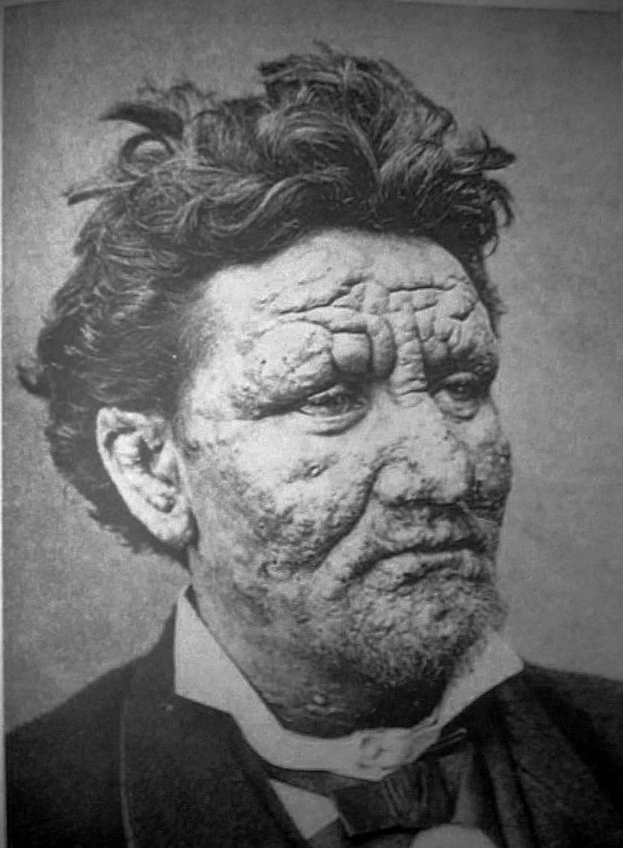
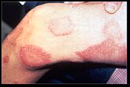
I. It’s Okay to Ask for Divine Healing.
A. These men had an incurable disease.
As he was going into a village, ten men who had leprosy met him. - v12

Slide 6
I. It’s Okay to Ask for Divine Healing.
A. These men had an incurable disease.
As he was going into a village, ten men who had leprosy met him. - v12
1. Leprosy * = word for several diseases, psoriasis, Hansen’s Disease.
* λεπρός

Slide 7
I. It’s Okay to Ask for Divine Healing.
2. Bible examples:
a. Moses.
Exodus 4:6-7 - Then the LORD said, “Put your hand inside your cloak.” So Moses put his hand into his cloak, and when he took it out, it was leprous, like snow. “Now put it back into your cloak,” he said. So Moses put his hand back into his cloak, and when he took it out, it was restored, like the rest of his flesh.

Slide 8
I. It’s Okay to Ask for Divine Healing.
2. Bible examples:
a. Moses. - Exodus 4:6-7
b. Miriam. - Numbers 12:9-16

Slide 9
I. It’s Okay to Ask for Divine Healing.
2. Bible examples:
a. Moses. - Exodus 4:6-7
b. Miriam. - Numbers 12:9-16
c. Naaman. - II Kings 5:1-14

Slide 10
I. It’s Okay to Ask for Divine Healing.
A. These men had an incurable disease.
B. They obeyed God.
As he was going into a village, ten men who had leprosy met him. They stood at a distance . . . - v12

Slide 11
I. It’s Okay to Ask for Divine Healing.
A. These men had an incurable disease.
B. They obeyed God.
How do we know?
As he was going into a village, ten men who had leprosy met him. They stood at a distance . . . - v12

Slide 12
I. It’s Okay to Ask for Divine Healing.
Leviticus 13:45-46
The person with such an infectious disease must wear torn clothes, let his hair be unkempt, cover the lower part of his face and cry out, ‘Unclean! Unclean!’ As long as he has the infection he remains unclean. He must live alone; he must live outside the camp.

Slide 13
I. It’s Okay to Ask for Divine Healing.
C. Who are the others who asked to be healed?

Slide 14
I. It’s Okay to Ask for Divine Healing.
C. Who are the others who asked to be healed?
The Man with Leprosy
Matthew 8:1-3

Slide 15
I. It’s Okay to Ask for Divine Healing.
C. Who are the others who asked to be healed?
Blind Bartimaeus
Mark 10:46-52

Slide 16
I. It’s Okay to Ask for Divine Healing.
C. Who are the others who asked to be healed?
The Royal Official’s Son
John 4:46-54

Slide 17
I. It’s Okay to Ask for Divine Healing.
D. They all believed Jesus had the power to heal them!
They stood at a distance and called out in a loud voice, “Jesus, Master, have pity on us!” - v13

Slide 18
I. It’s Okay to Ask for Divine Healing.
D. They all believed Jesus had the power to heal them!
They stood at a distance and called out in a loud voice, “Jesus, Master, have pity on us!” - v13
One of them, when he saw he was healed, came back, praising God in a loud voice. - v15
Same word - φωνή

Slide 19
I. It’s Okay to Ask for Divine Healing.
D. They all believed Jesus had the power to heal them!
2. What provided their healing?
Then he said to him, “Rise and go; your faith has made you well.” - v19

Slide 20
I. It’s Okay to Ask for Divine Healing
- v12-13
II. It’s Okay to Expect Results from Your Prayers
When he saw them, he said, “Go, show yourselves to the priests.” And as they went, they were cleansed. - v14

Slide 21
II. It’s Okay to Expect Results from Your Prayers.
When he saw them, he said, “Go, show yourselves to the priests.” And as they went, they were cleansed. - v14
A. They obeyed the Lord Who told them “Show yourselves to the priests”.

Slide 22
II. It’s Okay to Expect Results from Your Prayers.
When he saw them, he said, “Go, show yourselves to the priests.” And as they went, they were cleansed. - v14
A. They obeyed the Lord Who told them “Show yourselves to the priests”.
1. To be considered “clean” they had to be cured or beyond the contagious stage.

Slide 23
II. It’s Okay to Expect Results from Your Prayers.
When he saw them, he said, “Go, show yourselves to the priests.” And as they went, they were cleansed. - v14
A. They obeyed the Lord Who told them “Show yourselves to the priests”.
2. To be inspected by the priest & be anointed.

Slide 24
II. It’s Okay to Expect Results from Your Prayers.
When he saw them, he said, “Go, show yourselves to the priests.” And as they went, they were cleansed. - v14
B. They started toward the Temple before they were healed!

Slide 25
II. It’s Okay to Expect Results from Your Prayers.
When he saw them, he said, “Go, show yourselves to the priests.” And as they went, they were cleansed. - v14
B. They started toward the Temple before they were healed!
1. Pray expectantly - thank the Lord in advance.
2. That’s praying in faith!

Slide 26
I. It’s Okay to Ask for Divine Healing
- v12-13
II. It’s Okay to Expect Results from Your Prayers - v14
III. It’s Okay to be Demonstrative in Expressing Your Gratitude - v15-18

Slide 27
III. It’s Okay to be Demonstrative in
Expressing Your Gratitude
A. This man expressed his gratitude enthusiastically!
One of them, when he saw he was healed, came back, praising God in a loud voice. He threw himself at Jesus’ feet and thanked him — and he was a Samaritan. - v15-16

Slide 28
III. It’s Okay to be Demonstrative in
Expressing Your Gratitude
A. This man expressed his gratitude enthusiastically!
One of them, when he saw he was healed, came back, praising God in a loud voice. He threw himself at Jesus’ feet and thanked him — and he was a Samaritan. - v15-16
. . . called out in a loud voice, “Jesus, Master, have pity on us!” - v13

Slide 29
III. It’s Okay to be Demonstrative in
Expressing Your Gratitude
A. This man expressed his gratitude enthusiastically!
One of them, when he saw he was healed, came back, praising God in a loud voice. He threw himself at Jesus’ feet and thanked him — and he was a Samaritan. - v15-16

Slide 30
III. It’s Okay to be Demonstrative in
Expressing Your Gratitude
B. The Lord expected to be thanked!
Jesus asked, “Were not all ten cleansed? Where are the other nine? Was no one found to return and give praise to God except this foreigner?” - v17-18

Slide 31
III. It’s Okay to be Demonstrative in
Expressing Your Gratitude
B. The Lord expected to be thanked!
Jesus asked, “Were not all ten cleansed? Where are the other nine? Was no one found to return and give praise to God except this foreigner?” - v17-18
He threw himself at Jesus’ feet and thanked him — and he was a Samaritan. - v16

Slide 32
To please the Lord
- talk to Him often.
Show your gratitude to Him.
He deserves it!

