Slide 1
The Lost Son

Slide 2
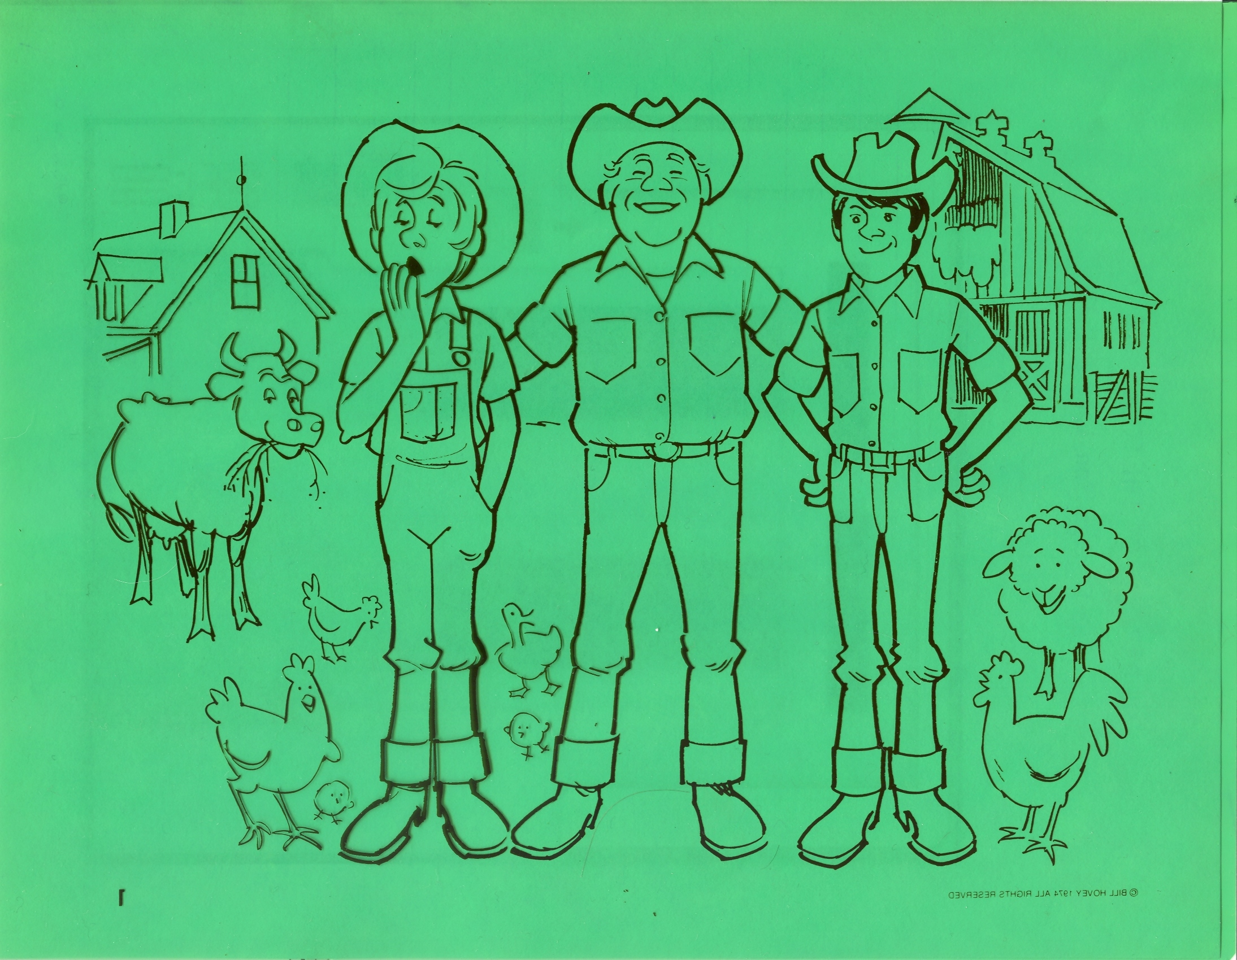
“There was a man who had two sons. – v11

Slide 3
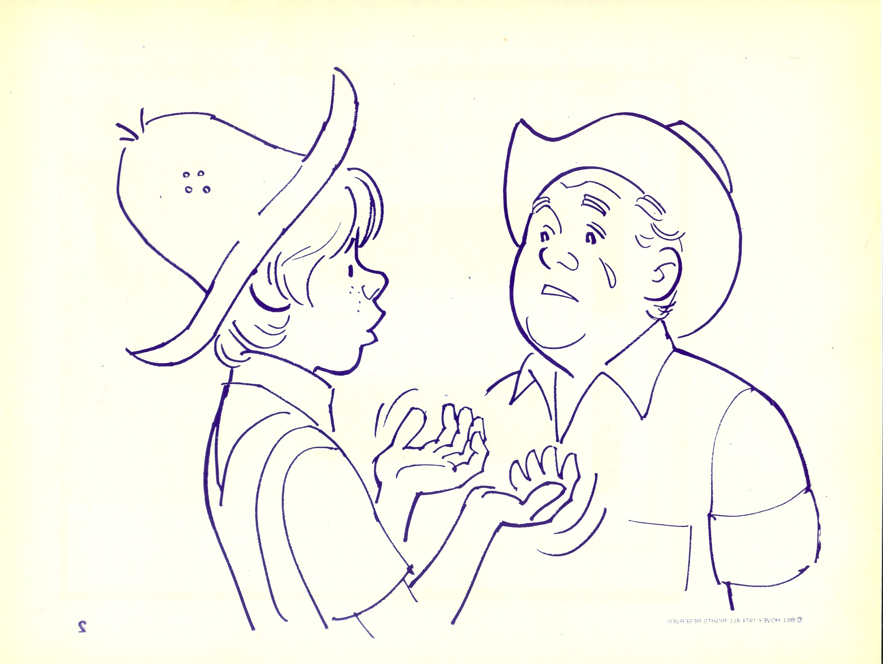
The younger one said to his father, ‘Father, give me my share of the estate.’ So he divided his property between them. – v12

Slide 4
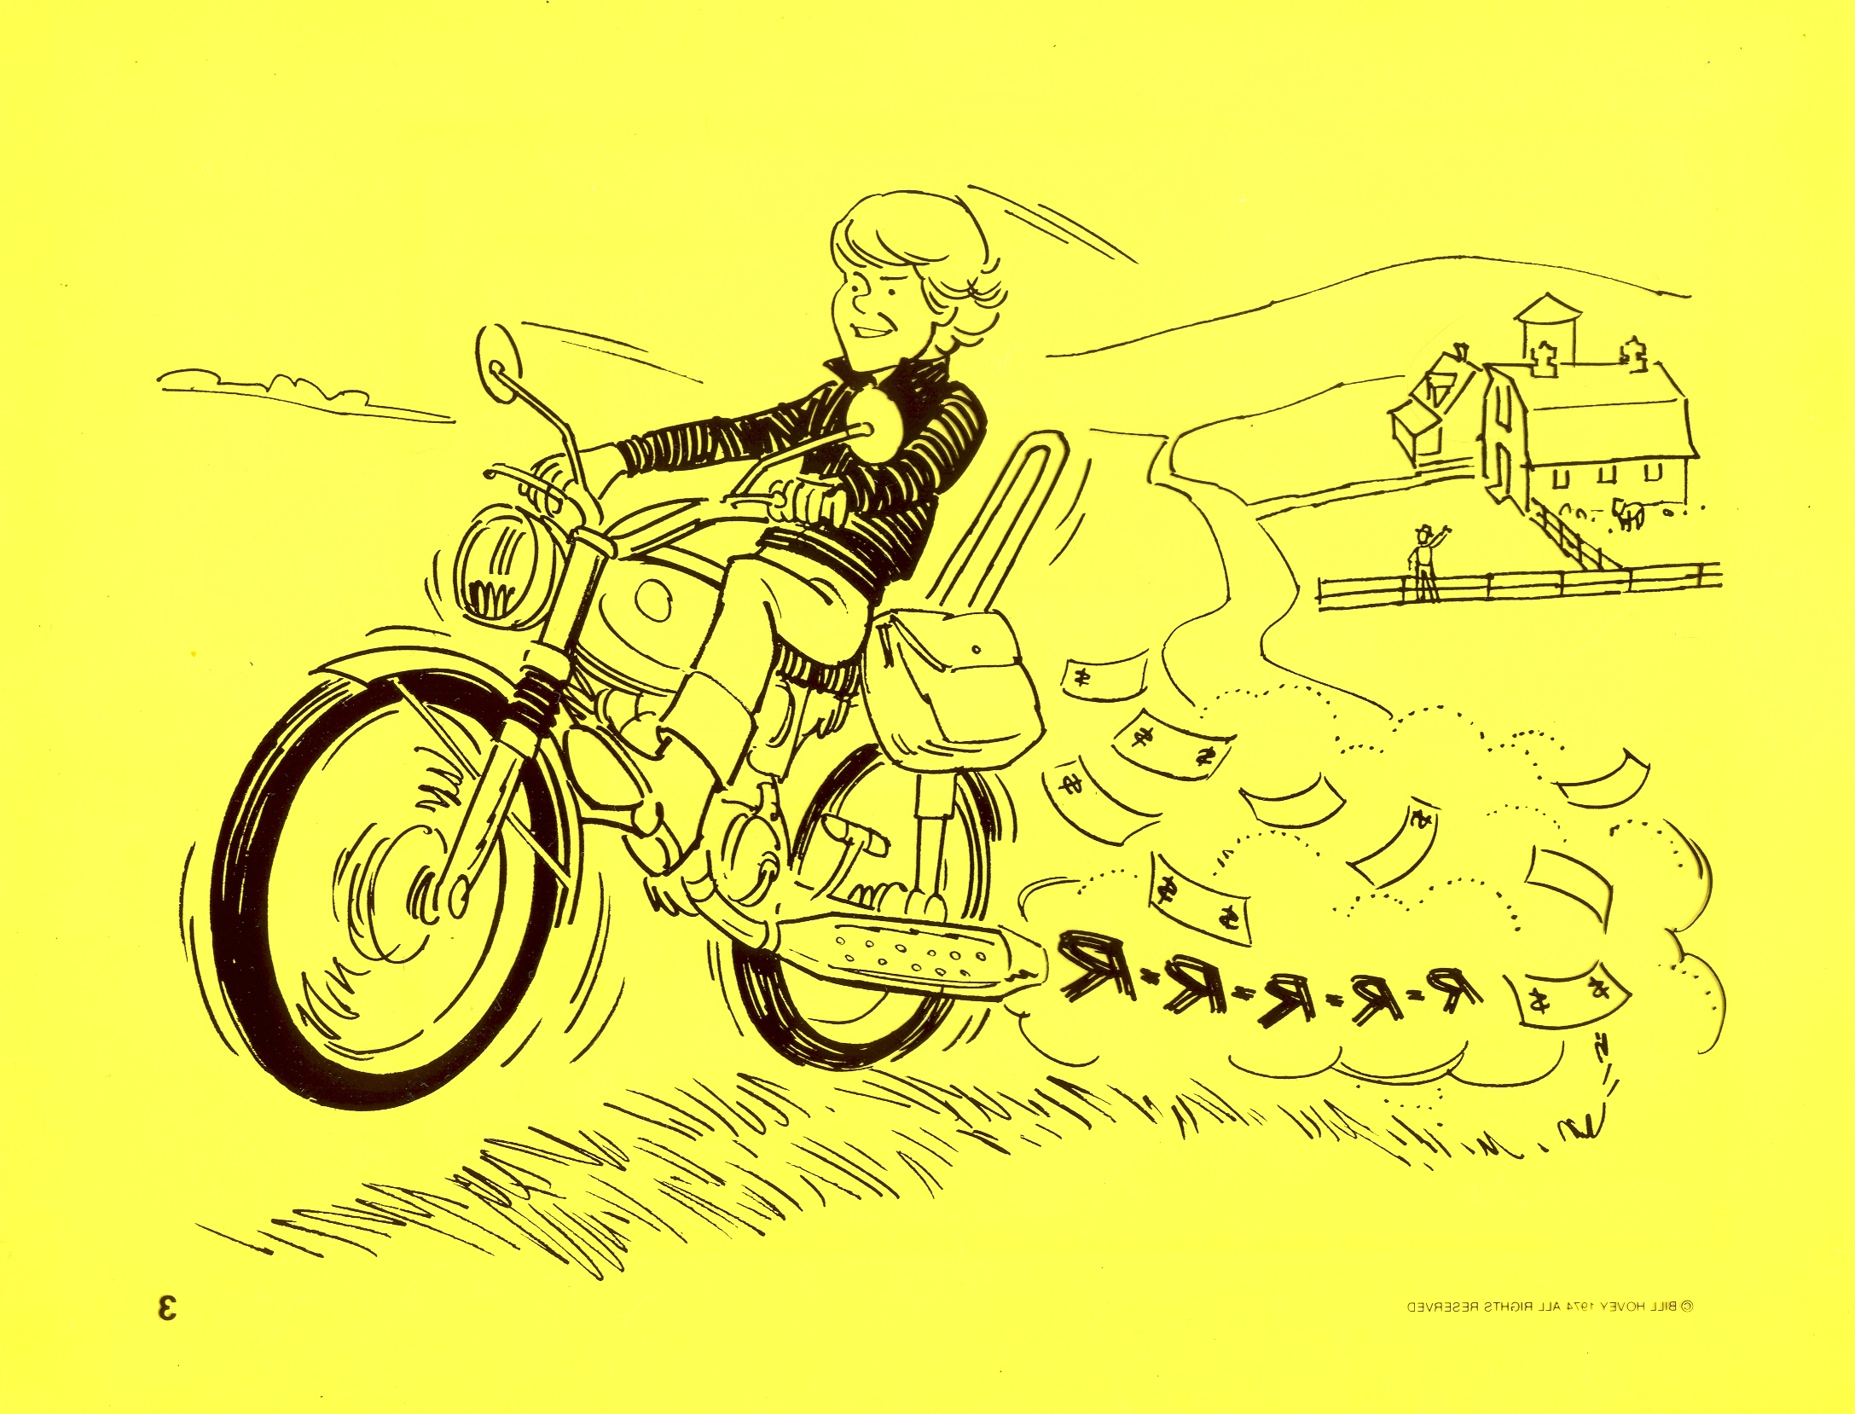
“Not long after that, the younger son got together all he had, set off for a distant country . . . – v13

Slide 5
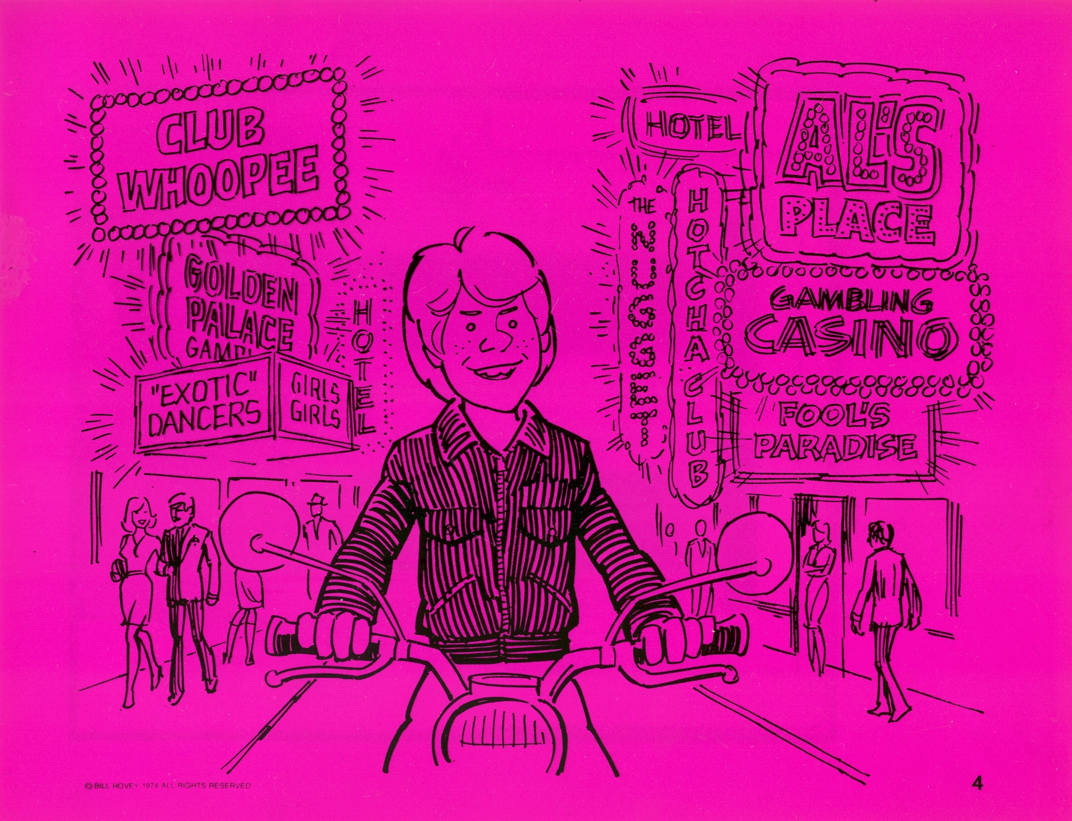
. . . and there squandered his wealth
in wild living. – v13

Slide 6
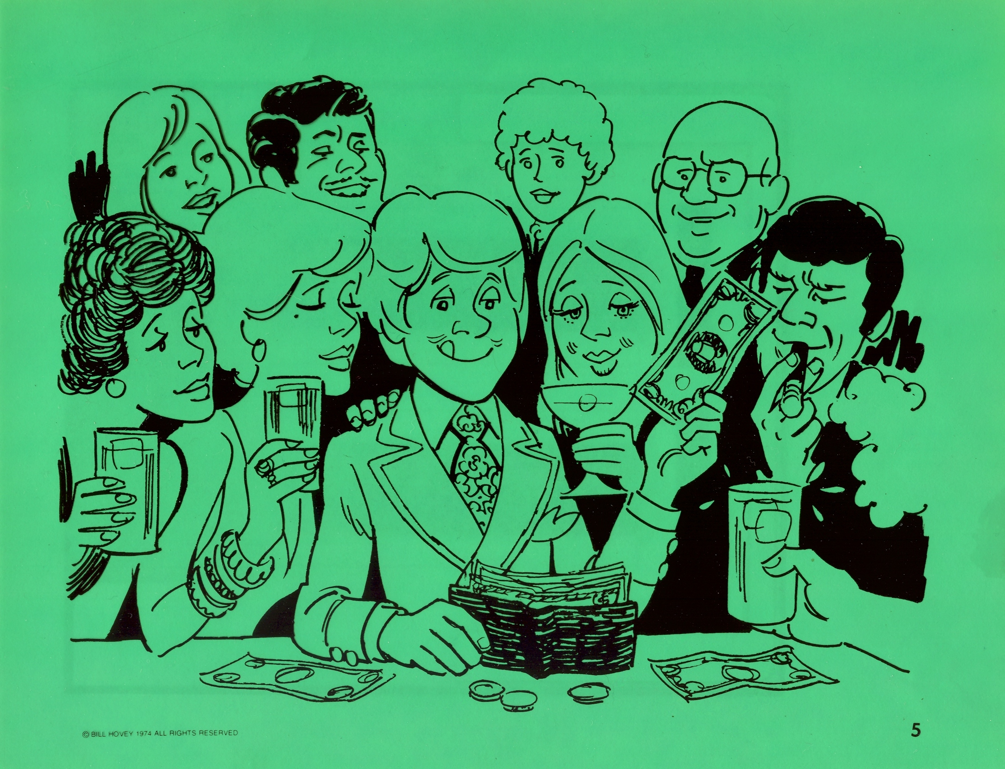
After he had spent everything . . . – v14

Slide 7
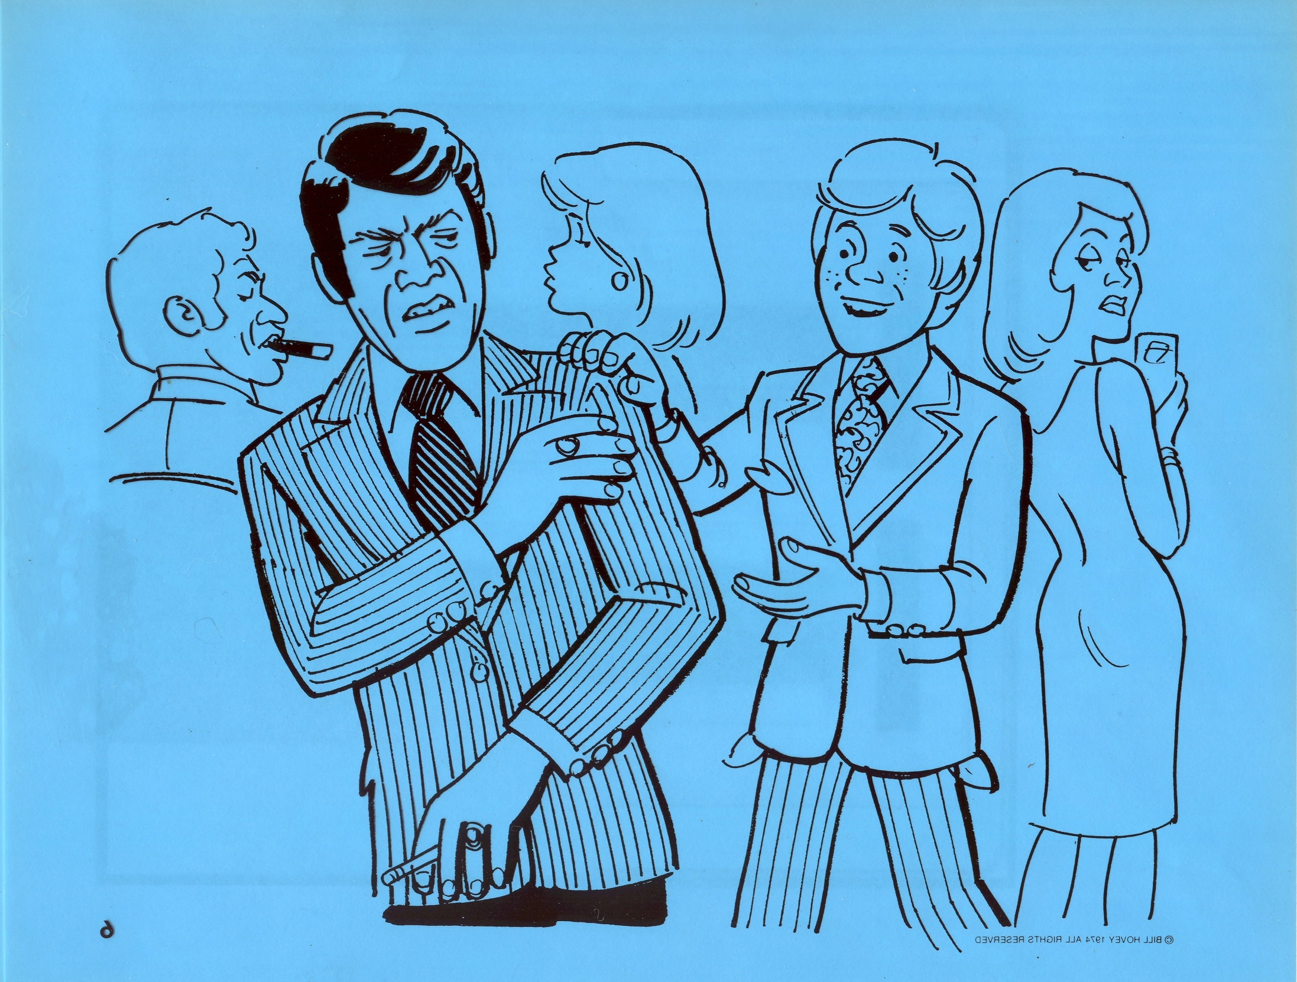
. . . there was a severe famine in that whole country, and he began to be in need. – v14

Slide 8
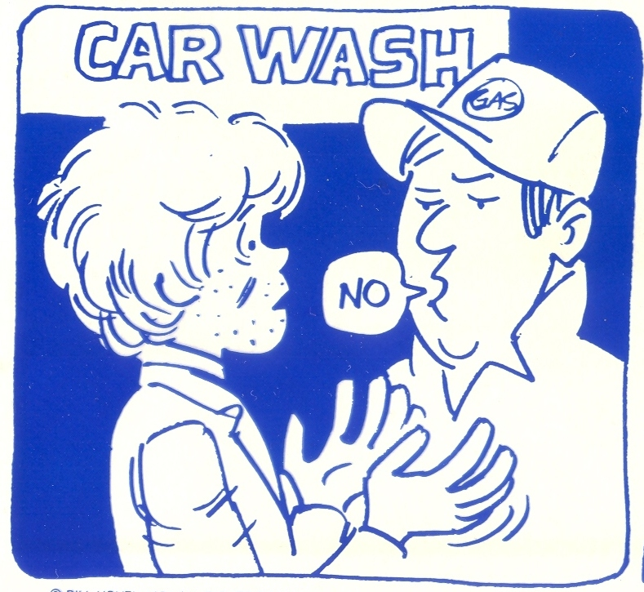

Slide 9
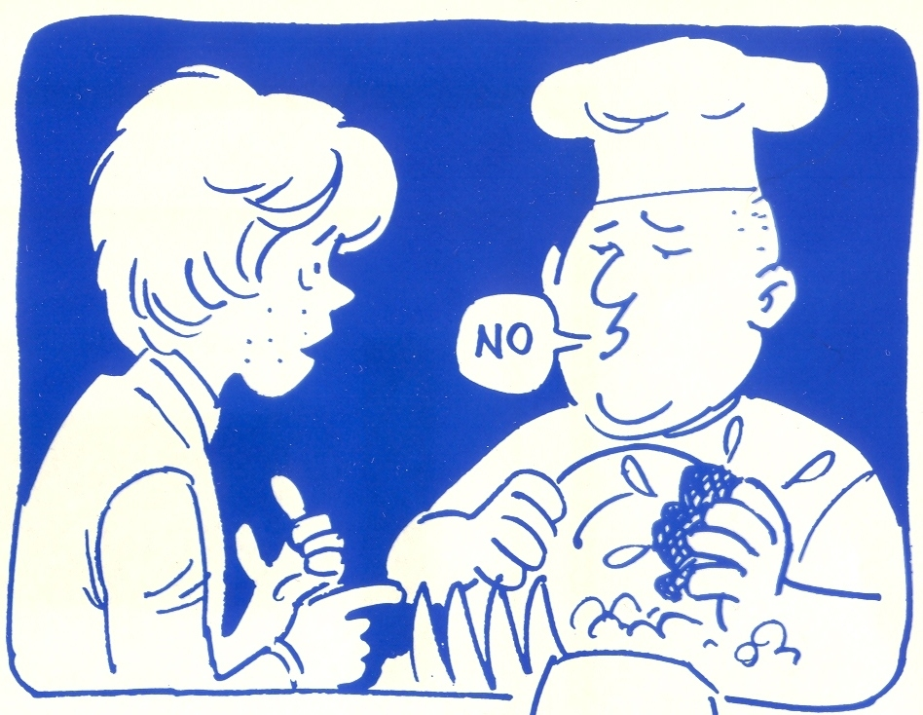

Slide 11
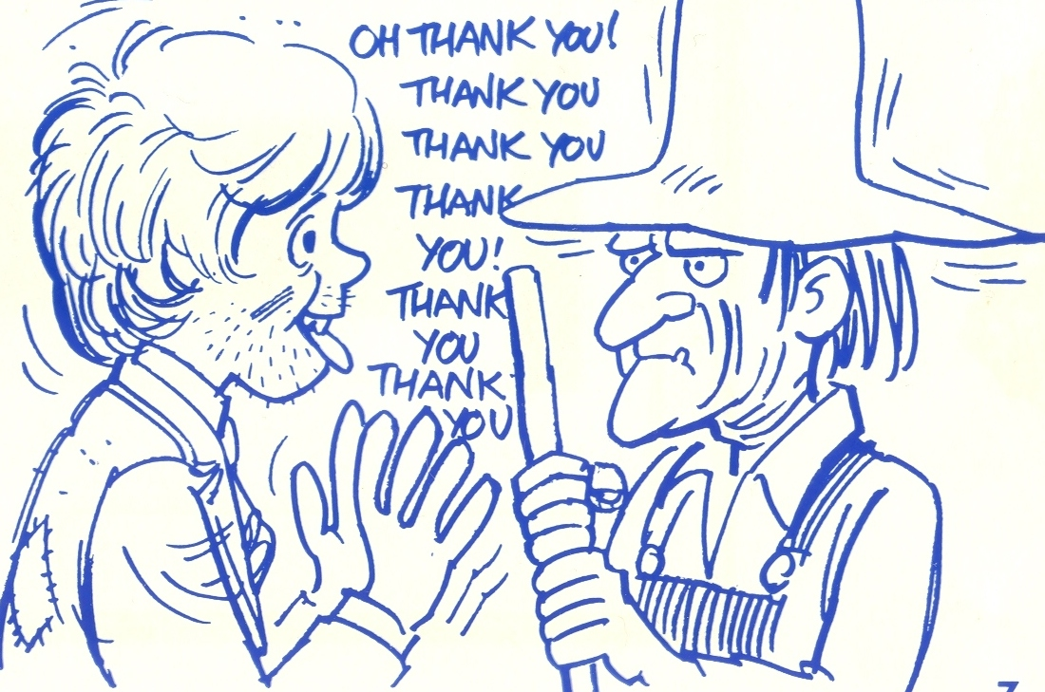
So he went and hired himself out to a citizen of that country . . . – v15

Slide 12
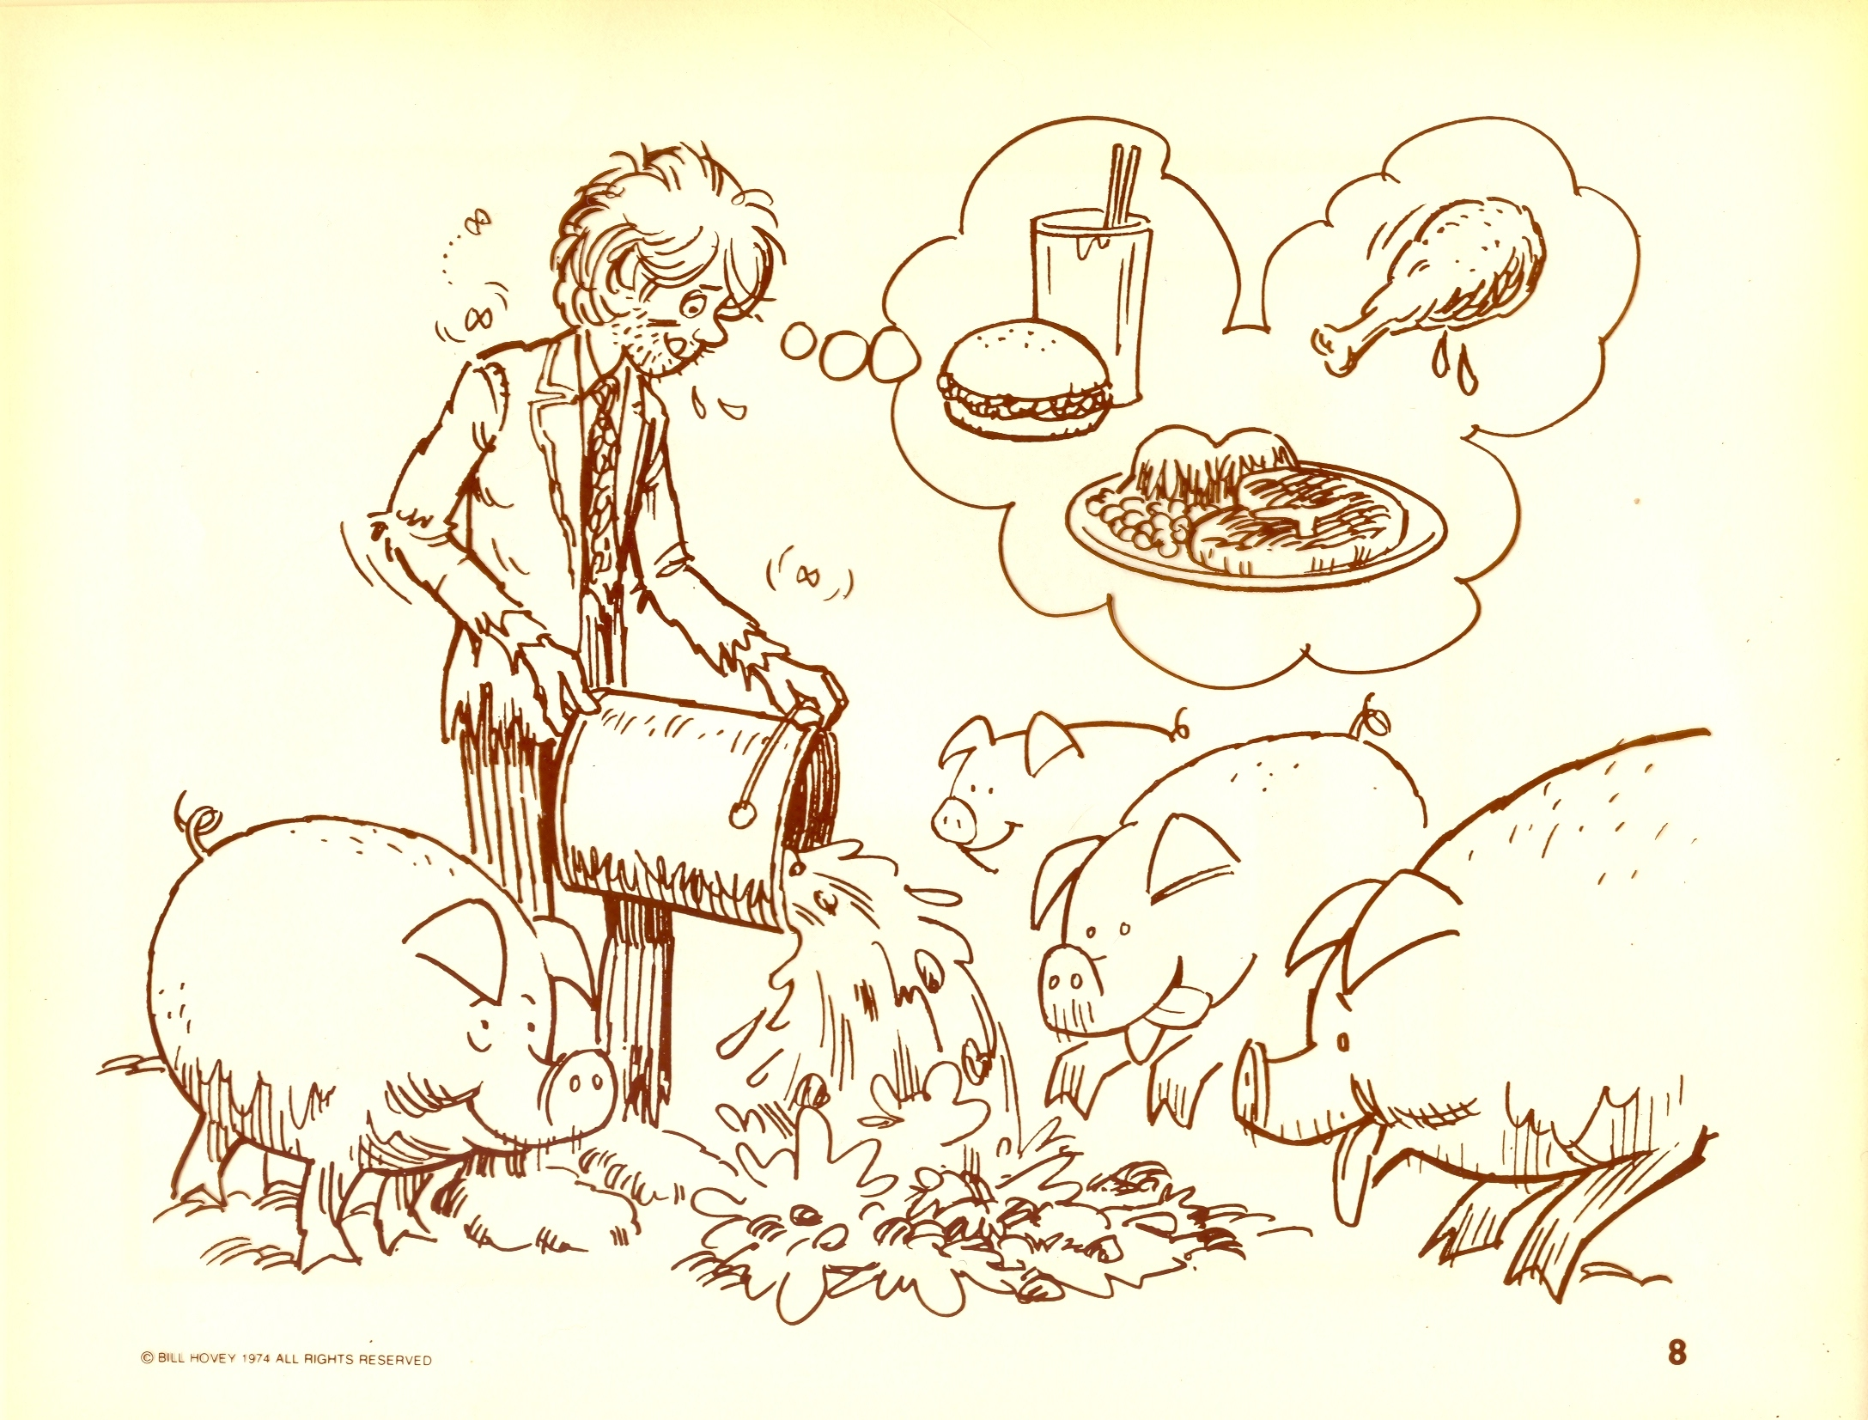
. . . who sent him to his fields to feed pigs. He longed to fill his stomach with the pods that the pigs were eating, but no one gave him anything.– v15-16

Slide 13
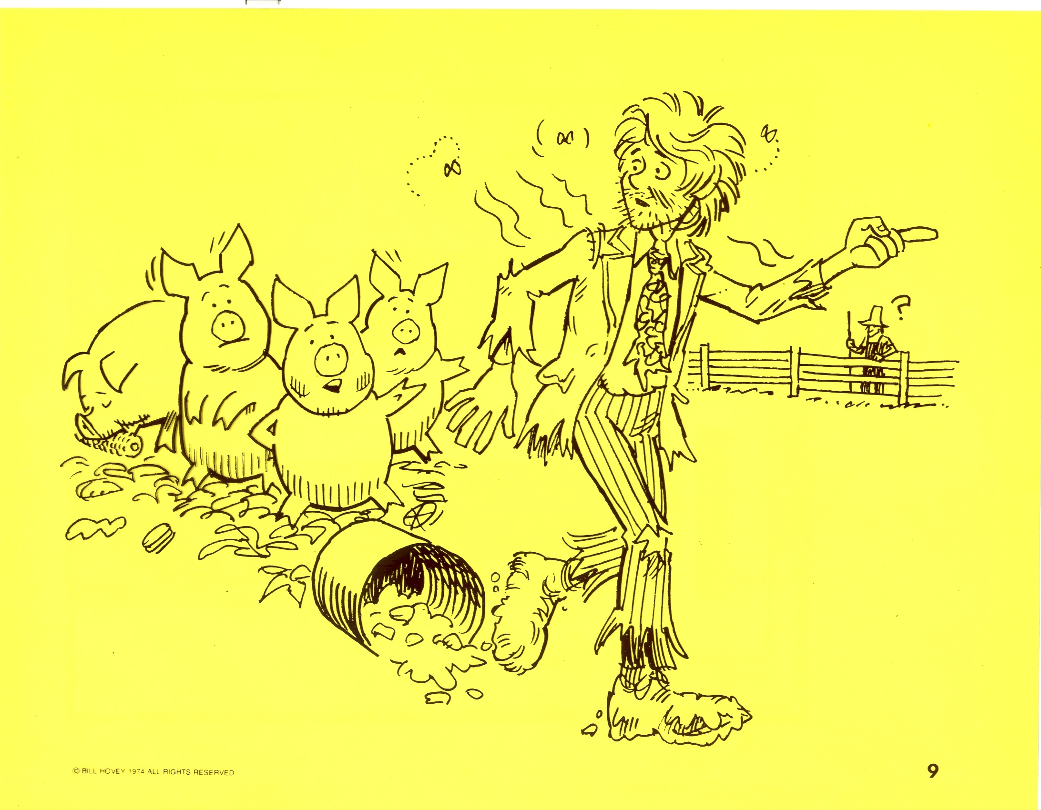
“When he came to his senses, he said, ‘How many of my father’s hired men have food to spare, and here I am starving to death! I will set out and go back to my father and say to him: Father, I have sinned against heaven and against you. I am no longer worthy to be called your son; make me like one of your hired men.’ So he got up and went to his father. – v17-20

Slide 14
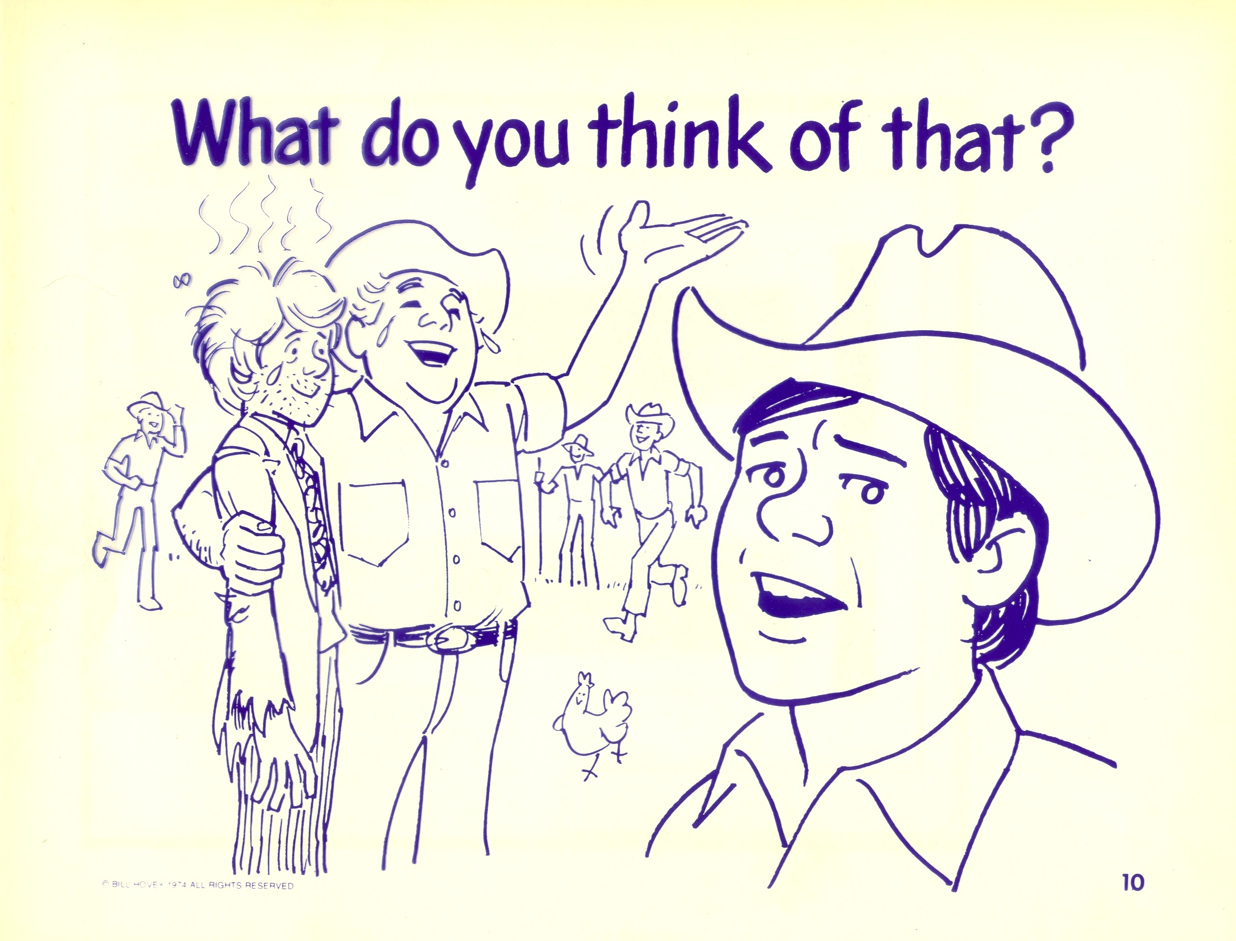
“But while he was still a long way off, his father saw him and was filled with compassion for him; he ran to his son, threw his arms around him and kissed him. – v20

Slide 15
Luke 15:21-24
“The son said to him, ‘Father, I have sinned against heaven and against you. I am no longer worthy to be called your son.’ “But the father said to his servants, ‘Quick! Bring the best robe and put it on him. Put a ring on his finger and sandals on his feet. Bring the fattened calf and kill it. Let’s have a feast and celebrate. For this son of mine was dead and is alive again; he was lost and is found.’ So they began to celebrate.

Slide 16
Luke 15:25-27
“Meanwhile, the older son was in the field. When he came near the house, he heard music and dancing. So he called one of the servants and asked him what was going on. ‘Your brother has come,’ he replied, ‘and your father has killed the fattened calf because he has him back safe and sound.’

Slide 17
Luke 15:28-32
“The older brother became angry and refused to go in. So his father went out and pleaded with him. But he answered his father, ‘Look! All these years I’ve been slaving for you and never disobeyed your orders. Yet you never gave me even a young goat so I could celebrate with my friends. But when this son of yours who has squandered your property with prostitutes comes home, you kill the fattened calf for him!’ “ ‘My son,’ the father said, ‘you are always with me, and everything I have is yours. But we had to celebrate and be glad, because this brother of yours was dead and is alive again; he was lost and is found.’ ”

Slide 18
1. The Pharisee’s condemnation.
Now the tax collectors and “sinners” were all gathering around to hear him. But the Pharisees and the teachers of the law muttered, “This man welcomes sinners and eats with them.” – Luke 15:1-2

Slide 19
2. The Lord’s Answer.
“Come to me all who are weary & burdened, & I will give you rest” – Matthew 11:28

Slide 20
2. The Lord’s Answer.
“Come to me all who are weary & burdened, & I will give you rest” – Matthew 11:28
Luke 14:16-23

Slide 21
3. The Lord wants all to enjoy His kingdom.

Slide 22
I. He Came to a Distant Country – v11-16

Slide 23
I. He Came to a Distant Country
A. He separated himself from his dad & his family.

Slide 24
I. He Came to a Distant Country
A. He separated himself from his dad & his family.
1. What is sin?

Slide 25
I. He Came to a Distant Country
A. He separated himself from his dad & his family.
The younger one said to his father, ‘Father, give me my share of the estate. – v12
2. Sin is the “I want it now” attitude.

Slide 26
I. He Came to a Distant Country
A. He separated himself from his dad & his family.
Genesis 3:1-19
3. Sin is rebellion against God’s plan for you.

Slide 27
I. He Came to a Distant Country
A. He separated himself from his dad & his family.
. . . Set off for a distant country and there squandered his wealth in wild living. – v13
4. Sin separates you from the Lord.

Slide 28
I. He Came to a Distant Country
A. He separated himself from his dad & his family.
. . . Set off for a distant country and there squandered his wealth in wild living. – v13
5. Sin is mismanagement of your Heavenly Father’s property.

Slide 29
I. He Came to a Distant Country
B. The result of sin is slopping the hogs!
So he went and hired himself out to a citizen of that country, who sent him to his fields to feed pigs. He longed to fill his stomach with the pods that the pigs were eating, but no one gave him anything.

Slide 30
I. He Came to a Distant Country
B. The result of sin is slopping the hogs!
1. The world believes that slopping the hogs is where it’s at.

Slide 31
I. He Came to a Distant Country
B. The result of sin is slopping the hogs!
1. The world believes that slopping the hogs is where it’s at.
2. But you could be sitting at your Heavenly Father’s banquet!

Slide 32
I. He Came to a Distant Country – v11-16
II. He Came to His Senses – v17-19

Slide 33
II. He Came to His Senses
A. By an Awareness of His Condition.
“When he came to his senses, he said, ‘How many of my father’s hired men have food to spare, and here I am starving to death! – v17

Slide 34
II. He Came to His Senses
B. By an Resolution to do something about it.
I will set out and go back to my father and say to him: Father, I have sinned against heaven and against you. – v18

Slide 35
II. He Came to His Senses
B. By an Resolution to do something about it.
1. Repent * = make up your mind to change your life.
(v7 & v10)
* μετανοέω

Slide 36
II. He Came to His Senses
B. By an Resolution to do something about it.
2. He humbled himself & made his own choice to return.

Slide 37
II. He Came to His Senses
B. By an Resolution to do something about it.
2. He humbled himself & made his own choice to return.
Luke 9:51 - Jesus resolutely set out for Jerusalem.

Slide 38
I. He Came to a Distant Country – v11-16
II. He Came to His Senses – v17-19
III. He Came to a Compassionate Father – v20-24

Slide 39
III. He Came to a Compassionate Father
A. Full of Forgiveness.

Slide 40
III. He Came to a Compassionate Father
A. Full of Forgiveness.
I John 1:9 – If we confess our sins, he is faithful and just and will forgive us our sins and purify us from all unrighteousness.

Slide 41
III. He Came to a Compassionate Father
B. Full of Joy.

Slide 42
III. He Came to a Compassionate Father
B. Full of Joy.
1. Compassion * = his intestines ached.
* σπλαγχνίζω

Slide 43
III. He Came to a Compassionate Father
B. Full of Joy.
1. Compassion * = his intestines ached.
2. “Threw his arms around him” & continually kissing him.
* σπλαγχνίζω

Slide 44
III. He Came to a Compassionate Father
B. Full of Joy.
“The son said to him, ‘Father, I have sinned against heaven and against you. I am no longer worthy to be called your son . . . ’ – v21

Slide 45
III. He Came to a Compassionate Father
B. Full of Joy.
But the father said to his servants, ‘Quick! Bring the best robe and put it on him. Put a ring on his finger and sandals on his feet. Bring the fattened calf and kill it. Let’s have a feast and celebrate. For this son of mine was dead and is alive again; he was lost and is found.’ So they began to celebrate. – v22-24

Slide 46
I. He Came to a Distant Country – v11-16
II. He Came to His Senses – v17-19
III. He Came to a Compassionate Father – v20-24
IV. He Came to an Older Brother – v25-32

Slide 47
IV. He Came to an Older Brother
A. Full of Bitterness & Jealousy.
But he answered his father, ‘Look! All these years I’ve been slaving for you and never disobeyed your orders. Yet you never gave me even a young goat so I could celebrate with my friends. But when this son of yours who has squandered your property with prostitutes comes home, you kill the fattened calf for him!’ – v29-30

Slide 48
IV. He Came to an Older Brother
A. Full of Bitterness & Jealousy.
I Corinthians 3:3 - For since there is jealousy and quarreling among you, are you not worldly?

Slide 49
IV. He Came to an Older Brother
A. Full of Bitterness & Jealousy.
I Corinthians 3:3 - For since there is jealousy and quarreling among you, are you not worldly?
I Corinthians 13:4 - Love is patient, love is kind. It does not envy, it does not boast, it is not proud.

Slide 50
IV. He Came to an Older Brother
A. Full of Bitterness & Jealousy.
I Corinthians 3:3 - For since there is jealousy and quarreling among you, are you not worldly?
I Corinthians 13:4 - Love is patient, love is kind. It does not envy, it does not boast, it is not proud.
James 3:14 - But if you harbor bitter envy and selfish ambition in your hearts, do not boast about it or deny the truth.

Slide 51
IV. He Came to an Older Brother
B. When dad died he would possess everything!
“ ‘My son,’ the father said, ‘you are always with me, and everything I have is yours. – v31

Slide 52
IV. He Came to an Older Brother
C. Who do you identify with in this story?

Slide 53
IV. He Came to an Older Brother
C. Who do you identify with in this story?
1. The lost son?

Slide 54
IV. He Came to an Older Brother
C. Who do you identify with in this story?
1. The lost son?
2. The older brother?

Slide 55
IV. He Came to an Older Brother
C. Who do you identify with in this story?
1. The lost son?
2. The older brother?
3. The abandoned father?

Slide 56
IV. He Came to an Older Brother
You have to decide
1. Is the church a country club – or a hospital?

Slide 57
IV. He Came to an Older Brother
You have to decide
1. Is the church a country club – or a hospital?
2. The Lord is the Great Physician & came to seek & to save the lost!

