Slide 1
let the parade begin!

Slide 2
I. What is the Historical Back- ground?

Slide 3
I. What is the Historical Background?
A. Alexander the Great dies. (323 BC)

Slide 4
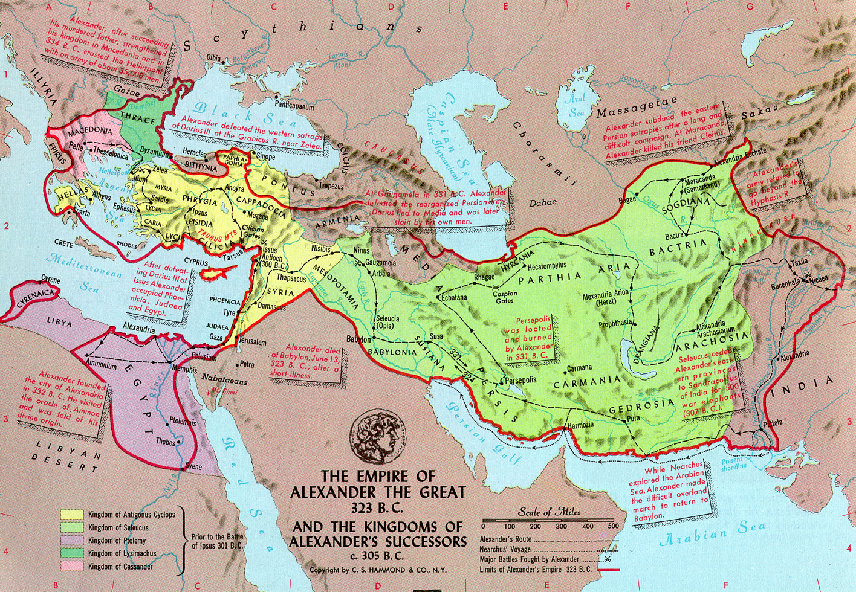
I. What is the Historical Background?
A.

Slide 5
I. What is the Historical Background?
A. Alexander the Great dies. (323 BC)
1. First Syrian/Egypt War.
Antiochus III vs. Ptolemy V
Syria takes Palestine

Slide 6
I. What is the Historical Background?
A. Alexander the Great dies. (323 BC)
2. Second Syrian/Egypt War.
Antiochus IV vs. Ptolemy VI
Rome Intervenes

Slide 7
I. What is the Historical Background?
B. Jewish Civil War in Jerusalem.
Pharisees vs. Hellenizers - Pro-Greek

Slide 8
I. What is the Historical Background?
B. Jewish Civil War in Jerusalem.
The Abomination of Desolation

Slide 9
I. What is the Historical Background?
B. Jewish Civil War in Jerusalem.
His armed forces will rise up to desecrate the temple fortress and will abolish the daily sacrifice. Then they will set up the abomination that causes desolation . . . From the time that the daily sacrifice is abolished and the abomination that causes desolation is set up, there will be 1,290 days. - Daniel 11:31 & 12:11

Slide 10
I. What is the Historical Background?
B. Jewish Civil War in Jerusalem.
So when you see standing in the holy place the abomination that causes desolation, spoken of through the prophet Daniel — let the reader understand - then let those who are in Judea flee to the mountains. - Matthew 24:15-16
When you see the abomination that causes desolation standing where it does not belong — let the reader understand — then let those who are in Judea flee to the mountains. - Mark 13:14

Slide 11
I. What is the Historical Background?
C. Cleansing of the Temple. (164 BC)
I Maccabees 13:51 - On the twenty-third day of the second month, in the one hundred seventy-first year, the Jews entered it with praise and palm branches, and with harps and cymbals and stringed instruments, and with hymns and songs, because a great enemy had been crushed and removed from Israel.

Slide 12
I. What is the Historical Background?
C. Cleansing of the Temple. (164 BC)
I Maccabees 13:51 - On the twenty-third day of the second month, in the one hundred seventy-first year, the Jews entered it with praise and palm branches, and with harps and cymbals and stringed instruments, and with hymns and songs, because a great enemy had been crushed and removed from Israel.
Hanukkah - The Feast of Lights

Slide 13
Matthew 21:1-3
As they approached Jerusalem and came to Bethphage on the Mount of Olives, Jesus sent two disciples, saying to them, “Go to the village ahead of you, and at once you will find a donkey tied there, with her colt by her. Untie them and bring them to me. If anyone says anything to you, tell him that the Lord needs them, and he will send them right away.

Slide 14
Matthew 21:4-8
This took place to fulfill what was spoken through the prophet: ‘See, your king comes to you, gentle and riding on a donkey, on a colt, the foal of a donkey.’ The disciples went and did as Jesus had instructed them. They brought the donkey and the colt, placed their cloaks on them, and Jesus sat on them. A very large crowd spread their cloaks on the road, while others cut branches from the trees and spread them on the road.

Slide 15
Matthew 21:9-11
The crowds that went ahead of him and those that followed shouted, “Hosanna to the Son of David!” “Blessed is he who comes in the name of the Lord!” “Hosanna in the highest!” When Jesus entered Jerusalem, the whole city was stirred and asked, “Who is this?” The crowds answered, “This is Jesus, the prophet from Nazareth in Galilee.”

Slide 16
Matthew 21:12-14
Jesus entered the temple area and drove out all who were buying and selling there. He overturned the tables of the money changers and the benches of those selling doves. It is written, he said to them, ‘My house will be called a house of prayer,’ but you are making it a ‘den of robbers.’ The blind and the lame came to him at the temple, and he healed them.

Slide 17
I. What is the Historical Back- ground?
II. The Triumphal Entry into Jeru-salem

Slide 18
II. The Triumphal Entry into Jerusalem.
A. Lord Jesus presents Himself as the Messiah!

Slide 19
II. The Triumphal Entry into Jerusalem.
A. Lord Jesus presents Himself as the Messiah!
They brought the donkey and the colt, placed their cloaks on them, and Jesus sat on them. - v7

Slide 20
II. The Triumphal Entry into Jerusalem.
A. Lord Jesus presents Himself as the Messiah!
This took place to fulfill what was spoken through the prophet: ‘See, your king comes to you, gentle and riding on a donkey, on a colt, the foal of a donkey.’ - 4-5.
Zechariah 9:9 - Rejoice greatly, O Daughter of Zion! Shout Daughter of Jerusalem! See, your king comes to you, righteous and having salvation, gentle and riding on a donkey, on a colt, the foul of a donkey.

Slide 21
II. The Triumphal Entry into Jerusalem.
A. Lord Jesus presents Himself as the Messiah!
This took place to fulfill what was spoken through the prophet: ‘See, your king comes to you, gentle and riding on a donkey, on a colt, the foal of a donkey.’ - v4-5.
Zechariah 9:9 - Rejoice greatly, O Daughter of Zion! Shout Daughter of Jerusalem! See, your king comes to you, righteous and having salvation, gentle and riding on a donkey, on a colt, the foul of a donkey.

Slide 22
II. The Triumphal Entry into Jerusalem.
A. Lord Jesus presents Himself as the Messiah!
This took place to fulfill what was spoken through the prophet: ‘See, your king comes to you, gentle and riding on a donkey, on a colt, the foal of a donkey.’ - v4-5
Zechariah 9:9 - Rejoice greatly, O Daughter of Zion! Shout Daughter of Jerusalem! See, your king comes to you, righteous and having salvation, gentle and riding on a donkey, on a colt, the foul of a donkey.

Slide 23
II. The Triumphal Entry into Jerusalem.
A. Lord Jesus presents Himself as the Messiah!
This took place to fulfill what was spoken through the prophet: ‘See, your king comes to you, gentle and riding on a donkey, on a colt, the foal of a donkey.’ - v4-5
It was Miraculous!

Slide 24
II. The Triumphal Entry into Jerusalem.
A. Lord Jesus presents Himself as the Messiah!
This took place to fulfill what was spoken through the prophet: ‘See, your king comes to you, gentle and riding on a donkey, on a colt, the foal of a donkey.’ - v4-5
Gentle * = Humble, not proud. He was a king of peace.
* πραΰς

Slide 25
II. The Triumphal Entry into Jerusalem.
A. Lord Jesus presents Himself as the Messiah!
They brought the donkey and the colt, placed their cloaks on them, and Jesus sat on them. A very large crowd spread their cloaks on the road, while others cut branches from the trees and spread them on the road. - v7-8

Slide 26
II. The Triumphal Entry into Jerusalem.
A. Lord Jesus presents Himself as the Messiah!
They brought the donkey and the colt, placed their cloaks on them, and Jesus sat on them. A very large crowd spread their cloaks on the road, while others cut branches from the trees and spread them on the road. - v7-8
II Kings 9:13 - They hurried and took their cloaks and spread them under him on the bare steps. Then they blew the trumpet and shouted, “Jehu is king!”

Slide 27
II. The Triumphal Entry into Jerusalem.
A. Lord Jesus presents Himself as the Messiah!
They brought the donkey and the colt, placed their cloaks on them, and Jesus sat on them. A very large crowd spread their cloaks on the road, while others cut branches from the trees and spread them on the road. - v7-8
I Maccabees 13:51 - . . . the Jews entered it with praise and palm branches . . .

Slide 28
II. The Triumphal Entry into Jerusalem.
A. Lord Jesus presents Himself as the Messiah!
The crowds that went ahead of him and those that followed shouted, “Hosanna to the Son of David!” “Blessed is he who comes in the name of the Lord!” “Hosanna in the highest!” - v9
Hosanna = Save us now!

Slide 29
II. The Triumphal Entry into Jerusalem.
A. Lord Jesus presents Himself as the Messiah!
The crowds that went ahead of him and those that followed shouted, “Hosanna to the Son of David!” “Blessed is he who comes in the name of the Lord!” “Hosanna in the highest!” - v9
Psalm 118:25 - O Lord, save us; O Lord, grant us success.

Slide 30
II. The Triumphal Entry into Jerusalem.
A. Lord Jesus presents Himself as the Messiah!
The crowds that went ahead of him and those that followed shouted, “Hosanna to the Son of David!” “Blessed is he who comes in the name of the Lord!” “Hosanna in the highest!” - v9

Slide 31
II. The Triumphal Entry into Jerusalem.
B. Lord Jesus presents Himself as the Cleanser of the Temple!
Jesus entered the temple area and drove out all who were buying and selling there. He overturned the tables of the money changers and the benches of those selling doves. It is written, he said to them, ‘My house will be called a house of prayer,’ but you are making it a ‘den of robbers.’ - v12-13

Slide 32
II. The Triumphal Entry into Jerusalem.
B. Lord Jesus presents Himself as the Cleanser of the Temple!
Malachi 3:1 - Suddenly the Lord you are seeking will come to His temple, the messenger of the covenant, whom you desire, will come, says the Lord Almighty.

Slide 33
II. The Triumphal Entry into Jerusalem.
B. Lord Jesus presents Himself as the Cleanser of the Temple!
A very large crowd spread their cloaks on the road, while others cut branches from the trees and spread them on the road. - v8.
Remember I Maccabees 13:51

Slide 34
II. The Triumphal Entry into Jerusalem.
B. Lord Jesus presents Himself as the Cleanser of the Temple!
It is written, he said to them, ‘My house will be called a house of prayer,’ but you are making it a ‘den of robbers.’- v13

Slide 35
II. The Triumphal Entry into Jerusalem.
B. Lord Jesus presents Himself as the Cleanser of the Temple!
It is written, he said to them, ‘My house will be called a house of prayer,’ but you are making it a ‘den of robbers.’- v13
Isaiah 56:7 - Their burnt offerings and sacrifices will be accepted on my altar; for my house will be called a house of prayer for all nations.

Slide 36
II. The Triumphal Entry into Jerusalem.
B. Lord Jesus presents Himself as the Cleanser of the Temple!
It is written, he said to them, ‘My house will be called a house of prayer,’ but you are making it a ‘den of robbers.’- v13
Jeremiah 7:11 - Has this house, which bears my name, become a den of robbers to you? But I have been watching! declares the Lord.

Slide 37
I. What is the Historical Back- ground?
II. The Triumphal Entry into Jeru-salem.
III. Let’s Join the Parade!

Slide 38
III. Let’s Join the Parade!
A. When the People not in the Parade asked, “Who is This Guy?” - The People in the Parade Told Them!
When Jesus entered Jerusalem, the whole city was stirred and asked, “Who is this?” The crowds answered, “This is Jesus, the prophet from Nazareth in Galilee.” - v10-11.

Slide 39
III. Let’s Join the Parade!
A. When the People not in the Parade asked, “Who is This Guy?” - The People in the Parade Told Them!
Mark 16:15 - Go into all the world and preach the good news to all creation.

Slide 40
III. Let’s Join the Parade!
A. When the People not in the Parade asked, “Who is This Guy?” - The People in the Parade Told Them!
Romans 6:16 - Don’t you know that when you offer yourselves to someone to obey him as slaves, you are slaves to the one whom you obey — whether you are slaves to sin, which leads to death, or to obedience, which leads to righteousness?

Slide 41
III. Let’s Join the Parade!
A. When the People not in the Parade asked, “Who is This Guy?” - The People in the Parade Told Them!
James 2:24 - You see that a person is justified by what he does and not by faith alone.

Slide 42
III. Let’s Join the Parade!
B. Just as Lord Jesus Cleansed the Temple - He can Cleanse You!
Jesus entered the temple area and drove out all who were buying and selling there. He overturned the tables of the money changers and the benches of those selling doves. It is written, he said to them, ‘My house will be called a house of prayer,’ but you are making it a ‘den of robbers.’ v12-13

Slide 43
III. Let’s Join the Parade!
B. Just as Lord Jesus Cleansed the Temple - He can Cleanse You!
Psalm 51:2 - Wash away all my iniquity and cleanse me from my sin.

Slide 44
III. Let’s Join the Parade!
B. Just as Lord Jesus Cleansed the Temple - He can Cleanse You!
Hebrews 9:14 - How much more, then, will the blood of Christ, who through the eternal Spirit offered Himself unblemished to God, cleanse our consciences from acts that lead to death, so that we may serve the living God!
Hebrews 10:22 - Let us draw near to God with a sincere heart in full assurance of faith, having our hearts sprinkled to cleanse us from a guilty conscience . . .

Slide 45
Let’s Join the Parade!

